Slide 1
NSF PUI Progress - Planning Grant for 21-528
Award #2201505: Computational Infusion for Missouri Undergraduate Science and Education (CIMUSE) Planning Grant

Slide 2
Why focus on Primarily Undergraduate Institutions?
Many of the Primarily Undergraduate Institutions (PUIs) in Missouri are substantially under-resourced and located in less-populated, connectivity-challenged areas.
Missouri PUIs vary widely in their experience with advanced networking and High-Performance Computing (HPC) usage.
There is wide variability in the adoption of new research and teaching resources including student access to meaningful STEM experiences enabled by a robust Cyberinfrastructure (CI).
While PUIs educate about 40% of STEM graduates, in 2020 less than 5% of NSF awards in Missouri went to PUIs.
Produce STEM graduates with hands-on HPC experience

Slide 3
Planning Project Goals
Create a series of National Science Foundation Campus Cyberinfrastructure (CC*) proposals
Provide robust access to a uniform set of shared resources:
  proven cyberinfrastructure designs,
  opportunities for research computing design, and
  operational support requirements.
Bring interested institutions together for demonstrations and discussion of existing resources, typical CI roles and responsibilities, and potential operational issues.
The first wave of researchers, science educators, and campus information technology staff will articulate long-term computing and networking needs, document science drivers and required computational resources, and coordinate state research network and campus CI plans for the first wave of CC* proposals.

Slide 4
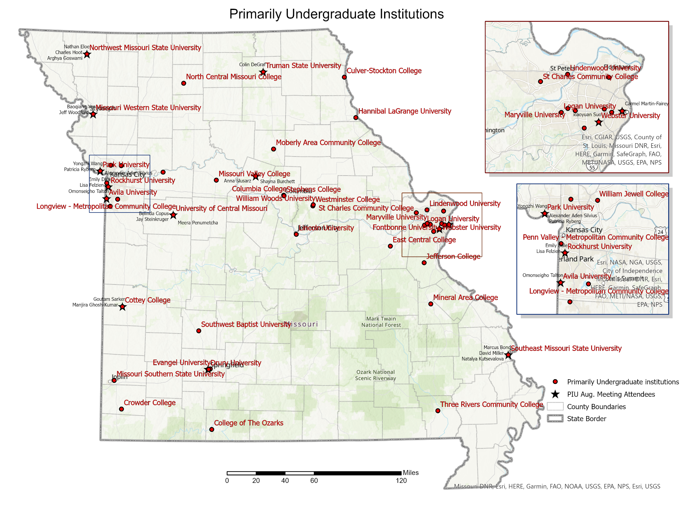
PUIs in Missouri

Slide 5
MOREnet’s Role
Primary Investigator (PI) for the planning grant and fiscally responsible
Contact and data collection for PUI STEM academic leaders, STEM faculty, and CIOs
Organize the two day workshop including speakers, registration, meals, lodging
Organize “First Wave” proposal teams to articulate science drivers, broader impacts, letter of commitment
Develop State-wide Cyber-Infrastructure (CI) plans
Co-author campus CI plans with “First Wave” IT leaders
Hire grant writer and develop NSF CC* proposal(s)

Slide 6
Project Outline (Key Deliverables)
Outreach (Q2/Q3 CY22):
  Contact CIOs. Email with Project Abstract, Fiber RFP and request for information.
  Contact Academic officer. Email with Project abstract, 2 invitations to CIMUSE workshop.
Dark Fiber RFP (Q2, Q3 CY22):
  Explore the availability of dark fiber for long-term research network.
  Explore funding opportunities for dark fiber.
.

Slide 7
Project Outline (Key Deliverables)
CIMUSE Workshop (Q3 CY22):
  August 1st and 2nd. Demonstrations and discussion of HPC and research networks.
  Presentations by HPC practitioners:
    Kurt Brorsen: Integrating Undergraduates into Computational Chemistry Research
    Filiz Bunyak Ersoy: Next Generation Image Data Analytics through AI/ML: Driving the Scientific Discovery in Life Sciences
    Maria Mills: Insights into single molecule measurements of enzyme dynamics from molecular dynamics simulations
    Steven Neshyba: Perspectives on climate-themed, computation-intensive pedagogy for undergraduates
    Predrag Lazic: Care and Feeding of an HPC
  Review NSF CC* grant requirements. Recruit first wave projects and participants.
  Two breakout groups to find common interests
.

Slide 8
Project Outline (Key Deliverables)
Develop First Wave NSF CC* Proposals (Q4 CY22/Q1 CY23):
  Build proposal frameworks and assign sections.
  Gather Science Drivers: Intellectual Merit, Broader Impacts of STEM research and instruction.
  Cyber Infrastructure plans for shared network and each campus.
Assemble and submit First Wave CC* Proposal(s) Q1 CY23:
  Grant writer will assemble proposal(s) and edit for continuity and grant compliance.
  Review by project teams. Final edits.
  Area 5 Regional Computing proposal in response to the NSF 23-525 CC* solicitation.

Slide 9
Chip Byers, Principal Investigator
chip@more.net
573.999.3641

