Slide 1
Information Security Trends
Becky Fowler
CISO – University of Missouri

Slide 2
Agenda
UM Security Overview
Identity Management Trends
Security Trends
Governance/Risk/Compliance Trends
VIP Relationships

Slide 3
UM Security Structure
CISO
UM System-level teams
  Identity Management
  Governance/Risk/Compliance
Campus Level teams (ISO+)

Slide 4
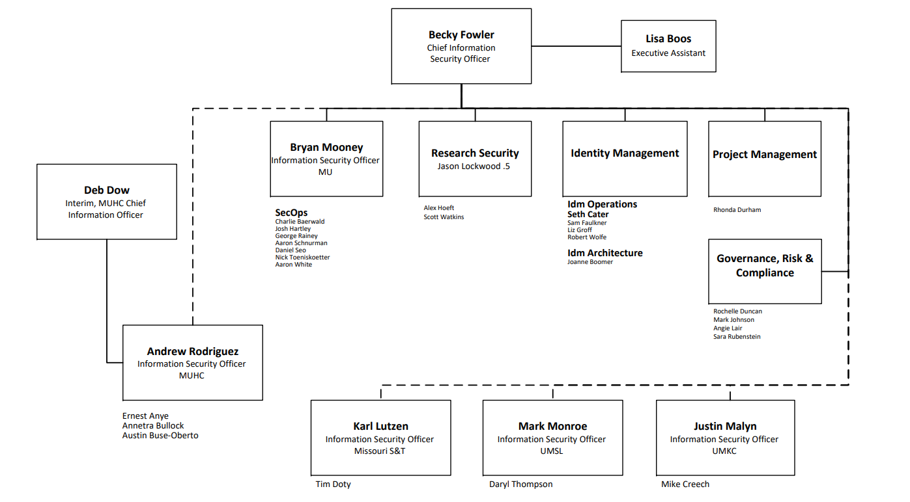
UM Org Chart

Slide 5
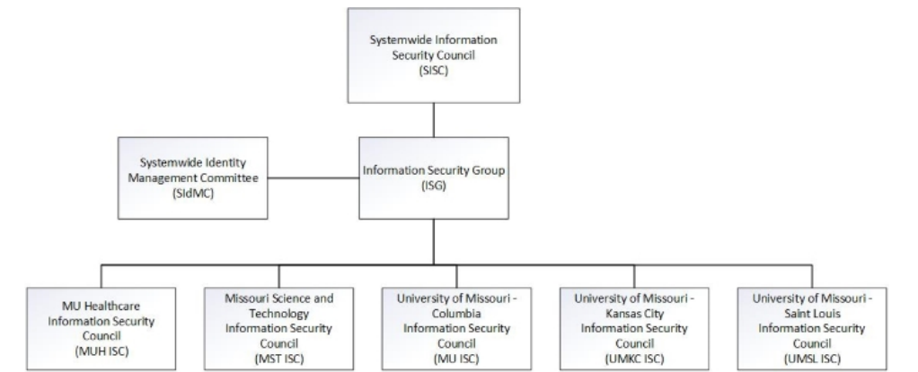
InfoSec Governance

Slide 6
Identity Management Trends
Single Sign On
Identity Lifecycle
  Identity/account creation
  Identity/account deprovisioning
Who gets access, when and how long?

Slide 7
Security Trends
Multi-factor Authentication (MFA)
Endpoint Management
Encryption
Data Loss Prevention (DLP)

Slide 8
Governance/Risk/Compliance
InfoSec Risk Management Program
  HIPAA, GLBA, FERPA, DOD requirements
Identify and manage risk
Document, document, document!

Slide 9
Relationship Building
Internal Audit/Risk Management
Privacy
Legal
Strategic Communication
Human Resources
Build and maintain these relationships!

