Slide 1
MOREnet Cybersecurity
Kathy Bellew
Connie Coy
John Riley
security@more.net

Slide 3
GLBA Safeguards Rule Update
Gramm-Leach-Bliley Act

Slide 4
Safeguards Rule
Amend Safeguards Rule – component of GLBA
Protects Student Financial Aid Information
Postsecondary Inst and 3rd party servicers
HE participate in federal student aid program
Effective date – June 9, 2023
Notes:
Requires financial institutions to implement security programs to protect customer information.

Slide 5
Key Elements
Designate a single qualified individual (QI)
Written Risk Assessment for IS program
Design IS safeguards to control risk – 8 specific types
Minimum required frequency unless “continuously monitoring”
  Vulnerability assessments
  Pen Testing
Notes:
Risk Assessment
Criteria to evaluate and categorize the IS risks and threats the institution faces;
Criteria to assess the quality of current IS system and underlying data integrity; and
Descriptions of how identified risks will be mitigated, accepted, or otherwise assessed, and how the IS program will analyze and address such risks.

Slide 6
Key Elements continued
Policy that provides specific Security Awareness training to IS
“Reasonable steps” in selecting vendors who safeguard data
Evaluation and adjustment due to results of testing and monitoring
Written Incident Response Plan
Annual mandatory reporting to Board of Directors

Slide 7
Limitations on Institutional Size
Maintain fewer than 5,000 consumer records
  Retained data of applicants
  Incoming freshman
  Program graduates/other students
Not Required
  QI report to Board of Directors
  Maintain a written risk assessment/IRP
  Conduct pen test or vulnerability assessments

Slide 8

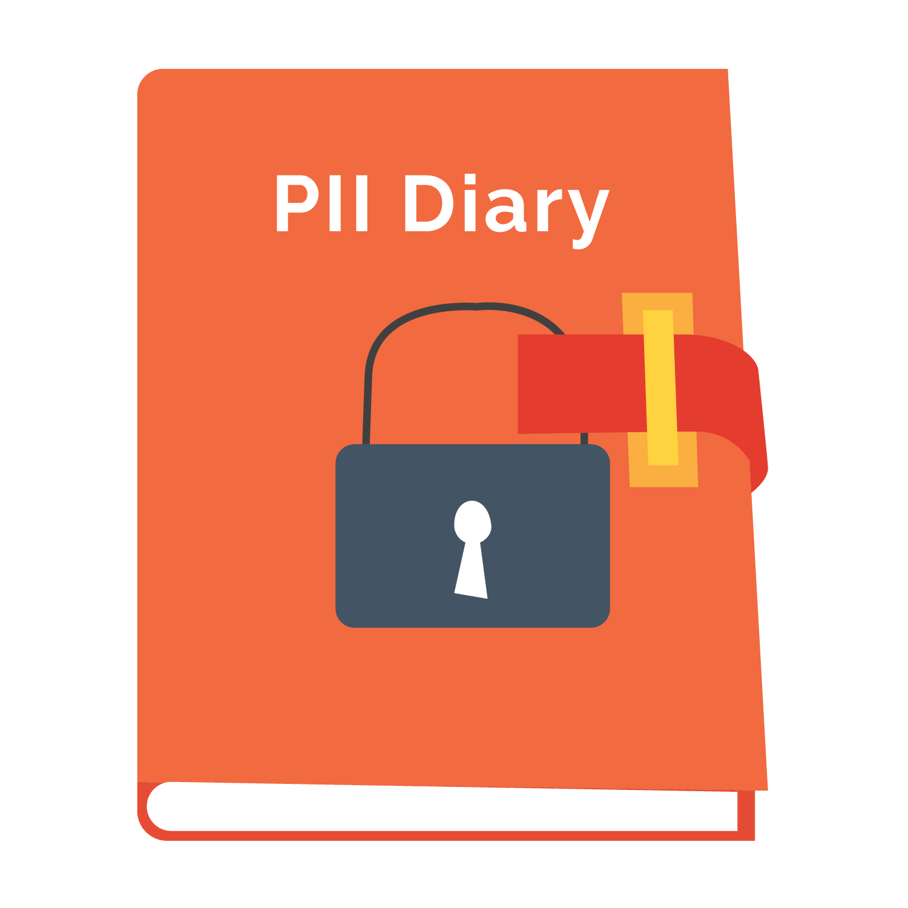
What are you doing?

Slide 9
Resources
Data Privacy on www.more.net
Incident Response Plan – email security@more.net
Included in on site assessments
https://www.ftc.gov/business-guidance/resources/ftc-safeguards-rule-what-your-business-needs-know

Slide 10

ARTIFICIAL INTELLIGENCE
AI

Slide 11
AI and Machine Learning (ML)
AI –the idea of a machine that can mimic human intelligence. Analyze and contextualize data without human interference.
ML-is a subset of AI. Teaching how to perform a task by identifying patterns. Use of technology and algorithms.

Slide 12
Examples of AI Used Today
Self driving and parking vehicles
Digital Assistants- Siri, Google, Alexa, Cortana
Robot Vacuums- Roomba

Slide 13
Interactive AI
ChatGPT
Google Bard
Bing
Other?
Do you use any of these?

Slide 14

Pros
Automate tasks
Accelerate decision making
Reduction of human error
Perform repetitive tasks freeing up humans for more complex operations
24/7 availability
Notes:
Detect and prevent attacks-IDS/IPS, EDR
Analyze data and assist with decisions

Slide 15

Cons
High cost of creation
No ethics
Misinformation
Risks to privacy
Risks to job loss

Slide 16

The Future of AI
Pause implementation and focus on research and development
Uses?
What else?

Slide 17

CYA
(Cover your Assets)
Preparing for Cyberinsurance requirements and how we can help.
Notes:
In 2021 Data breach average costs rose from USD 4.24 million to USD 9.44 million in 2022. Accordingly cyberinsurance rates have increased from 40 to 60% with some insurers considering ending coverage altogether

Slide 18
What are the requirements for MUSIC insurance deadline of July 2023
Multifactor authentication
Backups
Disaster recovery/incident response plans
Endpoint detection and response
Training and planning.

Slide 19
MFA - Why & How -
Multifactor authentication (MFA) improves cybersecurity by providing an additional layer of security beyond a typical username and password. MFA can block over 99.9% of account compromise attacks.(MS 2019)
Common types of MFA - something you have,know, are
Generating a one-time passcode with a smartphone app or sending one via text message. Text message, authentication apps (google, microsoft, authy)
Access badge, USB, or fob (Yubi key)
Biometrics such as fingerprints or facial scanning.
Many ways to implement MFA on your network. Azure, Google, Duo
Notes:
https://www.microsoft.com/en-us/security/blog/2019/08/20/one-simple-action-you-can-take-to-prevent-99-9-percent-of-account-attacks/
17 ESSENTIAL MULTI-FACTOR AUTHENTICATION (MFA) STATISTICS [2023]
https://www.zippia.com/advice/mfa-statistics/#:~:text=MFA%20success%20rates%3A-,MFA%20blocks%20a%20whopping%2099.9%25%20of%20modern%20automated%20cyberattacks.,automated%20cyberattacks%20is%20remarkably%20high.

Slide 20
MFA - Who
All remote access to the district/college network. VPN’s with MFA covers this
Email access on a non-owned/managed device
Privileged accounts and access such as domain and system administration
Any account that can install software on a device (even on premises).

Slide 21
Backups
Recommend Practices:
Store critical data in an ‘air-gapped’ (offline and inaccessible) system or cloud based systems.
Utilize 3-2-1 rule. Maintain three copies of data, on two different storage types, and at least one offsite. •
Data should be encrypted and accessible with unique credentials outside of active directory.
Test backups no less than annually.
MOREnet solutions: Datto SaaS, Alto and Siris: Veeam: Asigra

Slide 22
Disaster recovery/incident response plans
Documentation that shows the predetermined set of instructions/procedures to detect, respond to, and limit the impact of a cyber event or disaster.
Ensure all team members know their roles and responsibilities during a cyber event or disaster, and create a protocol for communication channels. Procedures for each phase of the recovery process. Communication plans with stakeholders, and contact information for all, such as insurance carriers and critical 3rd parties. • Test recovery plan at least annually.
How we can help. IR guides, technic, CISA, Tabletop exercises

Slide 23
Endpoint detection and response
Monitors end-user devices to detect and respond to cyber threats like ransomware and malware. Student Devices Not Required when segregated from primary network.
MOREnet has secured discounted pricing behind your MyMOREnet portal for:
Fortinet
Malwarebytes
Thirtyseven4
Crowdstrike EDR/MDR

Slide 24
Training and planning
1. Create an audited written plan for patching critical software and hardware.
MOREnet guide: Creating a patch management policy
2. Implement employee cybersecurity training, including phishing simulations. Phishing emails are responsible for 54% of ransomware infections. Segregate end-of-life software and hardware from the network, and decommission in a timely fashion.
Cyber security presentations. part of your membership
Infosec IQ - discount pricing

Slide 25
Secure email
Use protocols that protect email and/or email servers from outside interference by attackers. Can require manual configuration, but common tools like Google and Outlook may already be properly configured.
Demarc
spf
Dkim
MOREnet tech support can assist you in setting up.

Slide 26
Securing the Border
Firewalls: MOREnet has consortium pricing on Fortigate firewalls
DNS filtering: MOREnet has consortium pricing on Akamai SIA

Slide 27
Implement privileged access account security measures
Staff should only have access and permissions needed to perform their tasks and nothing more. When correct controls are in place risks associated with a breach are greatly reduced, because bad actors are limited to just what a user can access.
The majority of accounts should be established as user accounts, which should have limited direct access to crucial systems or administrative privileges.
Accounts should be reviewed for access yearly.

Slide 28
Vulnerability Assessments
MOREnet Cybersecurity assessments
security@more.net
Cisa - Risk and Vulnerability Assessments
CISAServiceDesk@cisa.dhs.gov

Slide 29
QUESTIONS?

