Slide 1
Workshop and Tabletop Agenda and Benefits
Workshop Agenda
Modern Cyber Risk Management
Visibility – The Key to Cybersecurity Maturity
The Growing Importance of Respond & Recover
Business Continuity and Disaster Recovery
Tabletop Agenda – Murder Mystery Format
Hands-On Incident Response Tabletop Exercise
Q&A
Wrap-up
Workshop & Tabletop Benefits
Reducing the time of an incident
Maintaining public trust.
Remaining compliant with security protocols
Establishing a confident threat response
Mitigating damage
Enhancing cybersecurity Improved preparation
Organized approach
Maximize cyber insurance and avoid pitfalls
Understand how BC and DR play into incidents
Notes:
Does your IT organization have a IR program for how to handle an incident?
Who would you involve internally for the initial investigation?
Do you have an incident response partner? Would you contact them immediately? Do you engage them through counsel?
How do you communicate to senior management? Do you notify the board?
Next steps? FBI?
What is the process? Is it network dependent?
Who is making the decisions?
Legal guidance
3rd party involvement
What steps do we take?
Remote clean up of all effected systems
System re-imaging
Open source research
Payment process

Slide 2
Cyber Attack Scenario and Assumptions
University in Missouri
It is Friday afternoon, 7:20PM Central
  Teachers, employees, and students will be back in class on Monday morning
  Roll-out of new high visibility application for teachers is in process
  The primary security engineer is on vacation and has limited access till Wednesday
  Nearly all of the cybersecurity spending over the last few years has been on detect and protect, not on respond and recover
  Initial Indicator of compromise missed: Support desk received emails from three users about not being able to access production applications
Notes:
Does your IT organization have a IR program for how to handle an incident?
Who would you involve internally for the initial investigation?
Do you have an incident response partner? Would you contact them immediately? Do you engage them through counsel?
How do you communicate to senior management? Do you notify the board?
Next steps? FBI?
What is the process? Is it network dependent?
Who is making the decisions?
Legal guidance
3rd party involvement
What steps do we take?
Remote clean up of all effected systems
System re-imaging
Open source research
Payment process

Slide 3
The Call - Saturday
CIO receives a call from Chancellor saying they cannot access their applications; more complaints from users about applications not being accessible
Support and engineers begin to investigate and notice extremely high activity on storage arrays that hold important data
Several applications and shared storage are inaccessible
Log data shows this activity has been going on since Friday night
Notes:
Questions:
Systems are not available, do you have recovery plans?
Can you pay BitCoin? Do you know how to procure?
How are you coordinating the investigation?
When do you contact your cyber insurance partner? Is ransomware or human error covered?
Does the FBI or your IR partner suggest paying the ransom?

Slide 4
Injection #1 - Another Piece of the Puzzle
Calls are received from more employees saying other applications are unresponsive as well. Two calls come in a little later from users that unable to log in
Engineers confirm that lots of data have been encrypted, including PHI & PII making the applications non-responsive. Ransomware confirmed
Leadership is beginning to ask uncomfortable questions
Questions are being asked about Incident Plan or Bus. Continuity
Notes:
Questions:
Systems are not available, do you have recovery plans?
Can you pay BitCoin? Do you know how to procure?
How are you coordinating the investigation?
When do you contact your cyber insurance partner? Is ransomware or human error covered?
Does the FBI or your IR partner suggest paying the ransom?

Slide 5
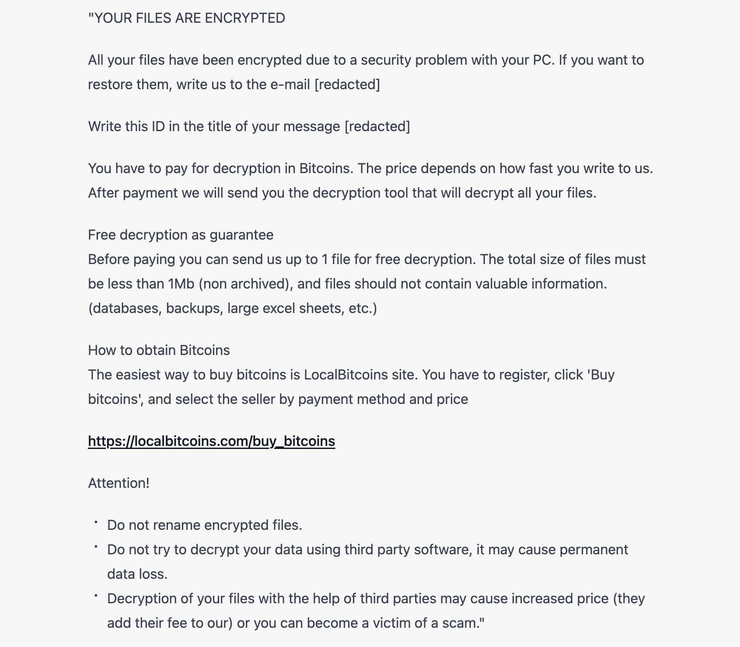
Injection #2 – Ransomware Email - Saturday
Notes:
Questions:
Systems are not available, do you have recovery plans?
Can you pay BitCoin? Do you know how to procure?
How are you coordinating the investigation?
When do you contact your cyber insurance partner? Is ransomware or human error covered?
Does the FBI or your IR partner suggest paying the ransom?

Slide 6
Cyber Attack Results
Ransomware was not stopped in time and was able to get to the backups and domain controllers
Cyber Insurance coverage was declined
Team was unprepared and turned on each other
Incident response planning was non-existent, and it hurt
No crisis public relations capability was in place or on retainer
Leadership not properly informed and not prepared for the chaos
The potential for extortion due to data exfiltration still exists
Team had little ability for forensic investigation or to determine cause
Notes:
Questions:
Systems are not available, do you have recovery plans?
Can you pay BitCoin? Do you know how to procure?
How are you coordinating the investigation?
When do you contact your cyber insurance partner? Is ransomware or human error covered?
Does the FBI or your IR partner suggest paying the ransom?

Slide 7
Cyber Attack – Review
Steps that may have prevented or improved your response:
  Understand cyber insurance requirements?
  Included leadership and important stake holders through the district in incident response and business continuity planning
  Ensure the incident response plan is part of the Emergency Response Plan
  Manage public relations – Have clear lines of responsibility for speaking to the outside about the incident and its impact
  Utilize a modern backup solution that uses air gapping or containers to ensure backup safety and availability
  Test, Test, test and Assess Regularly
Notes:
Does your IT organization have a IR program for how to handle an incident?
Who would you involve internally for the initial investigation?
Do you have an incident response partner? Would you contact them immediately? Do you engage them through counsel?
How do you communicate to senior management? Do you notify the board?
Next steps? FBI?
What is the process? Is it network dependent?
Who is making the decisions?
Legal guidance
3rd party involvement
What steps do we take?
Remote clean up of all effected systems
System re-imaging
Open source research
Payment process

