Slide 4
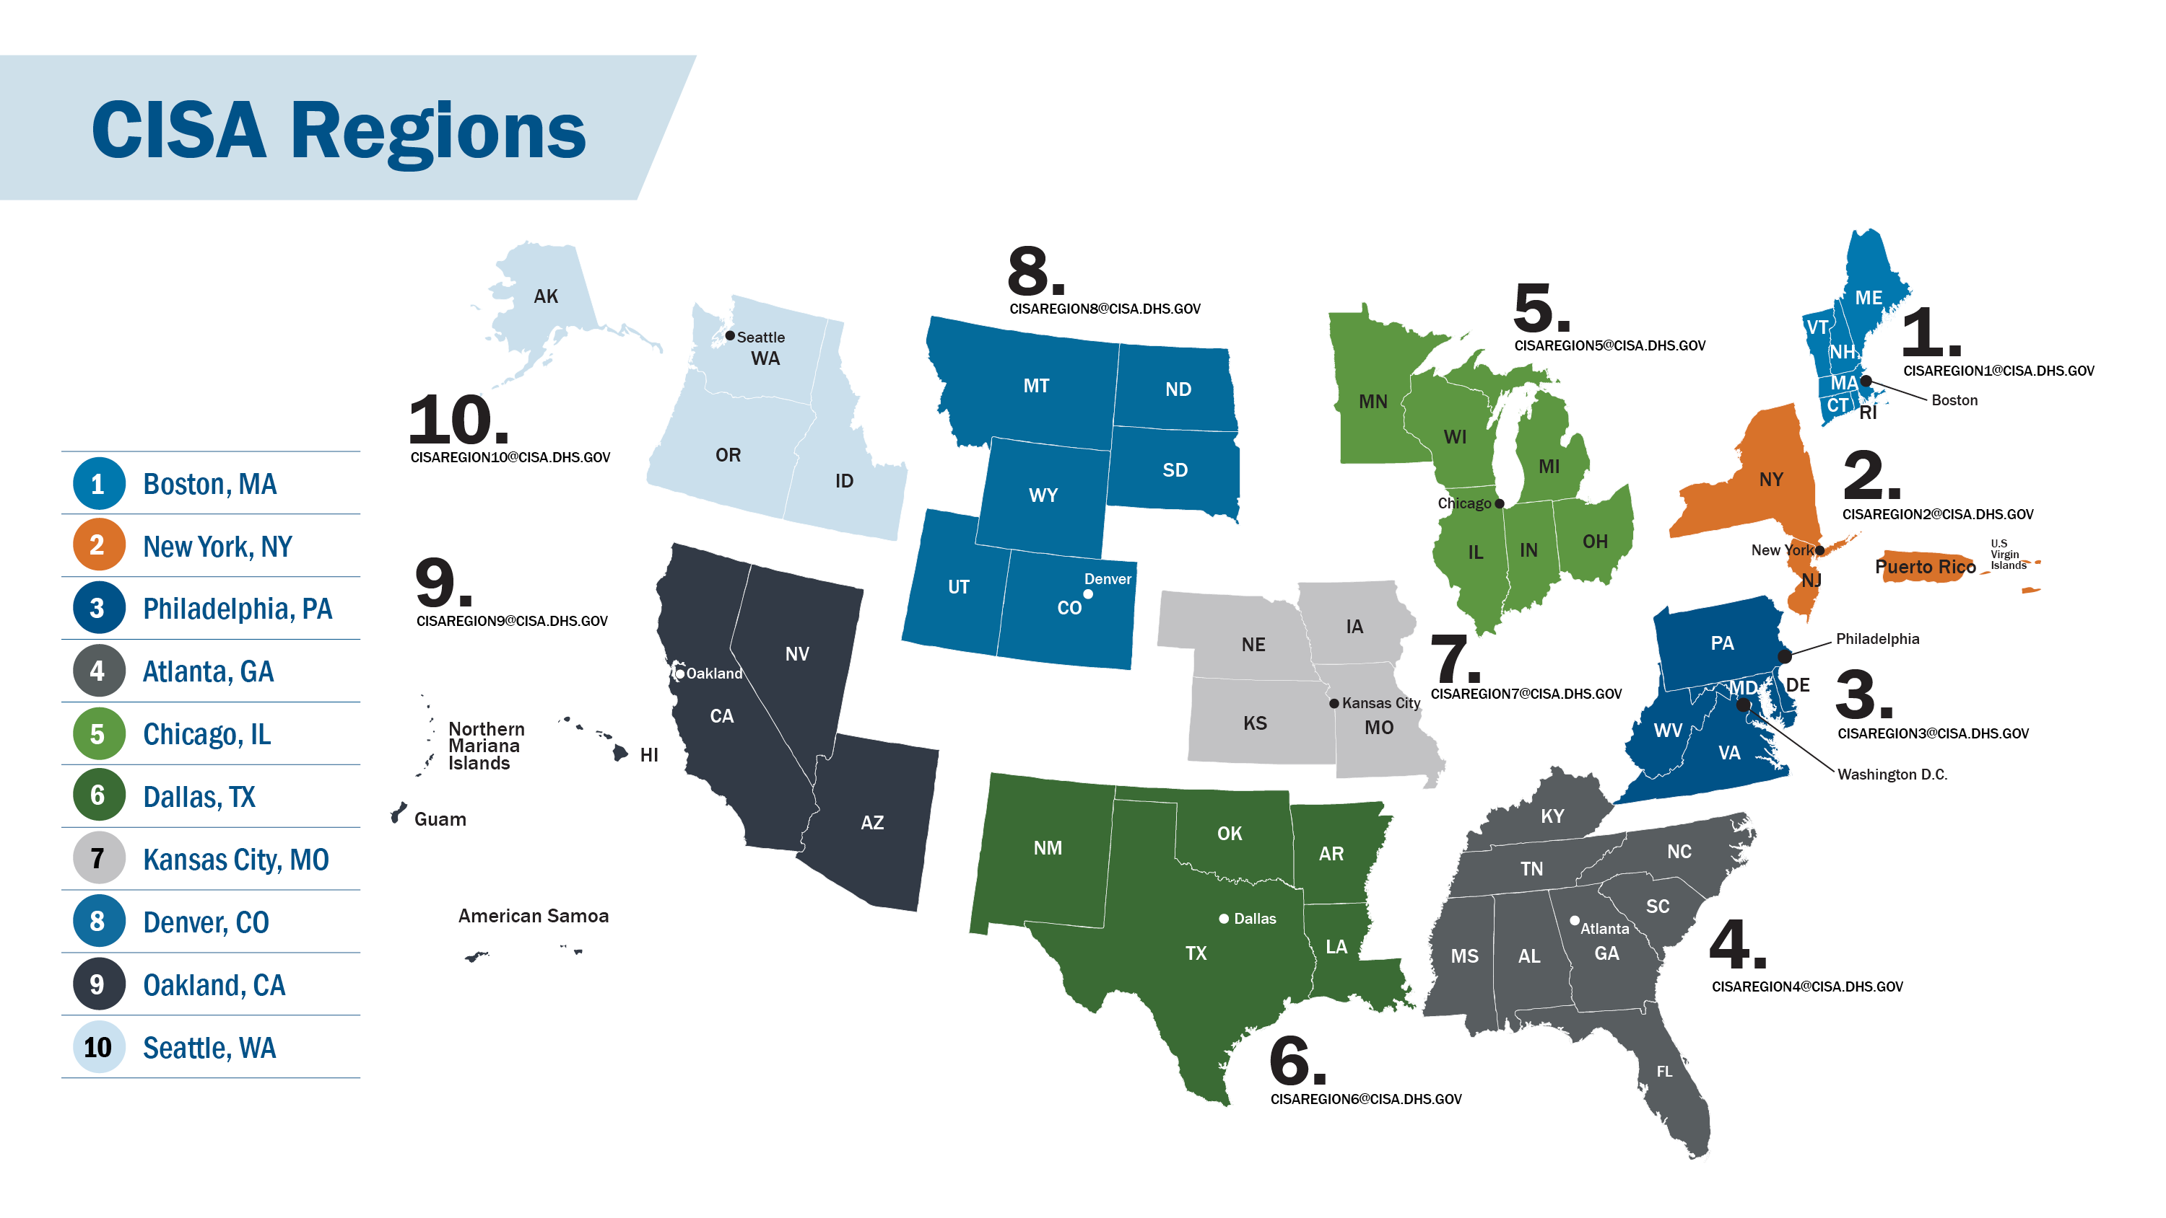

Slide 5
Entity Notifications
CISA has multiple authorities, including in Title XXII of the Homeland Security Act of 2002, as amended, to perform timely preventative vulnerability and cyber activity notifications to your organizations and clients. (RVWP, PRNI, and Admin Subpoena)
Our primary goal is to expeditiously give organizations information that could help prevent a cyber-attack or reduce harm when intrusion is in progress.
It takes a whole-of-community approach for CISA to be successful!
In Fiscal Year 23, CISA conducted over 2,268 entity notifications nation-wide.

Slide 6
Security Advisor Programs
Security Advisors are field-based critical infrastructure security specialists who link State, local, tribal, territorial (SLTT) & private sector stakeholders with infrastructure protection resources
Assess: Evaluate critical infrastructure risk.
Promote: Encourage best practices and risk mitigation strategies.
Build Capacity: Initiate, develop capacity, and support communities-of-interest and working groups.
Educate: Inform and raise awareness.
Listen: Collect stakeholder concerns & needs.
Coordinate: Bring together incident support and lessons learned.
Protective Security Advisors (PSA): Security, Emergency Preparedness, and Business Continuity Programs
Cybersecurity Advisors (CSA): Cybersecurity for Information Technology & Operational Technology networks

Slide 7
Who is targeting you?

Slide 8
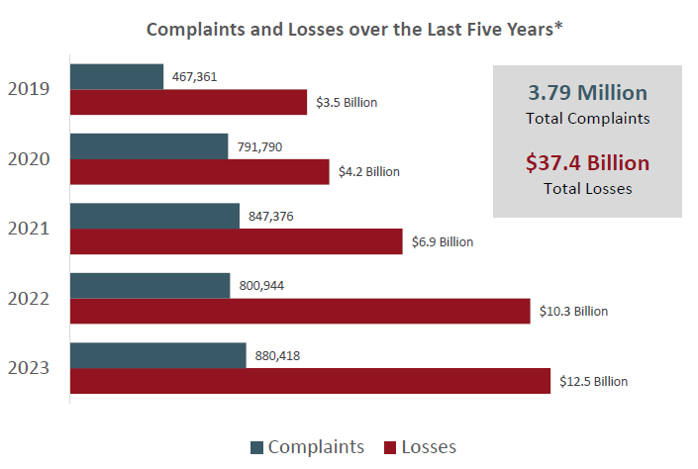
5 Year Trends – IC3 Internet Crime Report
Key take aways:
Over the last five years, the IC3 has received an average of 758,000 complaints per year.
Over 7.5 Billion in losses for 2023, were in Investment (4.5B) and Business Email Compromise (BEC) 2.9B.
MO ranked 22nd for # of complaint's filed (8108) and ranked 24th for losses @ $123.4 Million

Slide 9
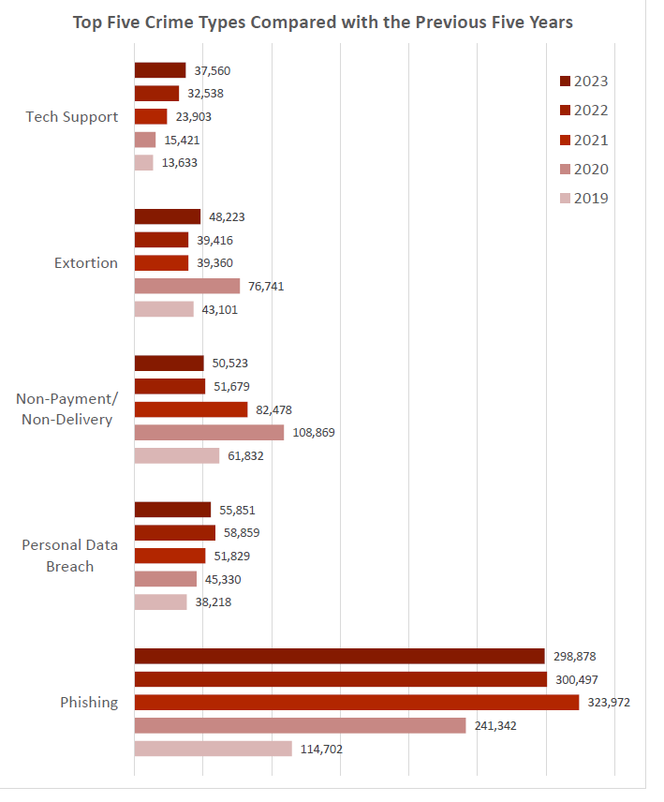
Top 5 Crime Types – IC3 Crime Report

Slide 10
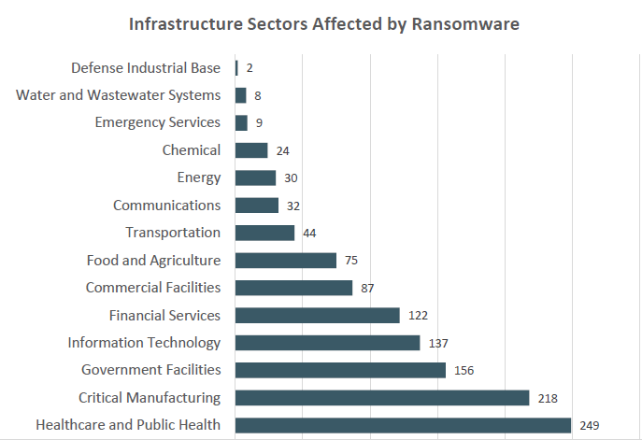
Infrastructure Sectors Hit by Ransomware
In 2023, IC3 received 1193 complaints indicating organizations belonging to a critical infrastructure sector were victims of Ransomware

Slide 11
Business Email Compromise
2022 Internet Crime Complaint Center received BEC complaints with losses exceeding $2.9B
21,832 complaints
$360M in calendar year 2016
Large & small companies
150 countries worldwide
Compromised email accounts
Spoofed or Typo-squatting
Spoofed Phone Numbers

Slide 12
Basic Stats
60% of Businesses that experience a Cyberattack close their doors within six months (National Cyber Security Alliance)
Companies should have a comprehensive disaster recovery plan in place to ensure that operations can continue even in the event of a breach. This includes regularly backing up data to an air-gapped resource and having a plan for quickly restoring operations.
Avg. cost of a breach to hit $4.2M (IBM)
Avg cost of a BEC attack is $130,000 (FBI)
37% of Ransomware victims that paid did not recover their data (Sophos)
40% of attacks are aimed at small business (Small Business Trends)
Small businesses should prioritize investing in cybersecurity defenses, including employee training and regular security audits.
53% of companies experienced a 3rd Party breach (Ponemon Institute)
Cyberattacks occur every 11 seconds (Cybersecurity Ventures)
As cyber attacks continue to increase in frequency and sophistication, companies will need to prioritize investing in advanced threat detection and response tools, including reviewing least access privileges, behavioral mapping and understanding of applications and their connections, to quickly identify and contain threats.
Over the last 12 months 43% of all reported ransomware victims were U.S. Organizations (Black kite)

Slide 13
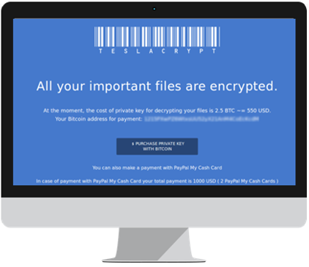
Ransomware
What is it?
How does it infect devices?
What happens after infection?
Should I pay the ransom?
How do I avoid infection?

Slide 14
2013 Target Breach
12 Dec 2013 the DOJ notified Target of a data breach affected 40M credit & debit card used between 27 Nov & 18 Dec
A Third-party HVAC vendor’s weak security practices allowed an attacker to gain a foothold in Target’s network.
Vender had remote access to Target’s network for electronic billing, contract submission, & project management purposes

Slide 15
2013 Target Breach
At least two months before the Target data breach began, attackers stole vender’s credentials via emails infected with malware
Attackers using vendor credential to move from less sensitive areas of network to areas storing consumer data
Malware utilized “RAM scraping” to collection unencrypted data as it passed through the point of sale (POS) machines before transfer to the payment processing provider
The “BlackPOS” malware was available on black market for $1,800 to $2,300

Slide 16
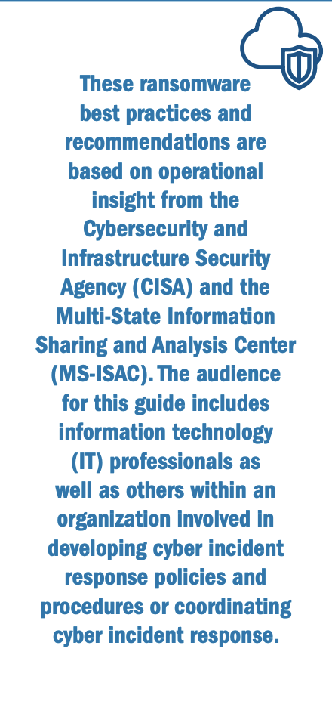
What Can You Do Today To Defend Yourself?
Maintain offline, encrypted backups & regularly test
Create, maintain, and exercise a Cyber Incident Response Plan (CIRP)
Conduct regular vulnerability scanning & address vulnerabilities, especially internet-facing devices
Secure & monitor external services (RDP)
Implement a user awareness & training program including identifying & reporting suspicious activity then test user awareness
Ensure antivirus & anti-malware toolsets are up-to-date
Consider risk management & cyber hygiene practices of third parties
Retain & secure logs from both network devices and local hosts
Use Multi-Factor Authentication
Update your operating system and software (patch)
Do not use end of life equipment and/or software

Slide 17
Steps to Secure Your Business
Mitigating Known Vulnerabilities
Network Segmentation
Phishing-Resistant
Basic Cybersecurity Training
Encrypt & Secure Sensitive Data
Email Security
Hardware & Software Approval Process
System Backups
Prohibit Connection of Unauthorized Devices
Passwords & User Accounts
Enforce Strong Passwords
Unique Credentials
Changing Default Passwords
Revoking Credentials for Departing Employees
Multi-Factor Authentication (MFA)

Slide 18
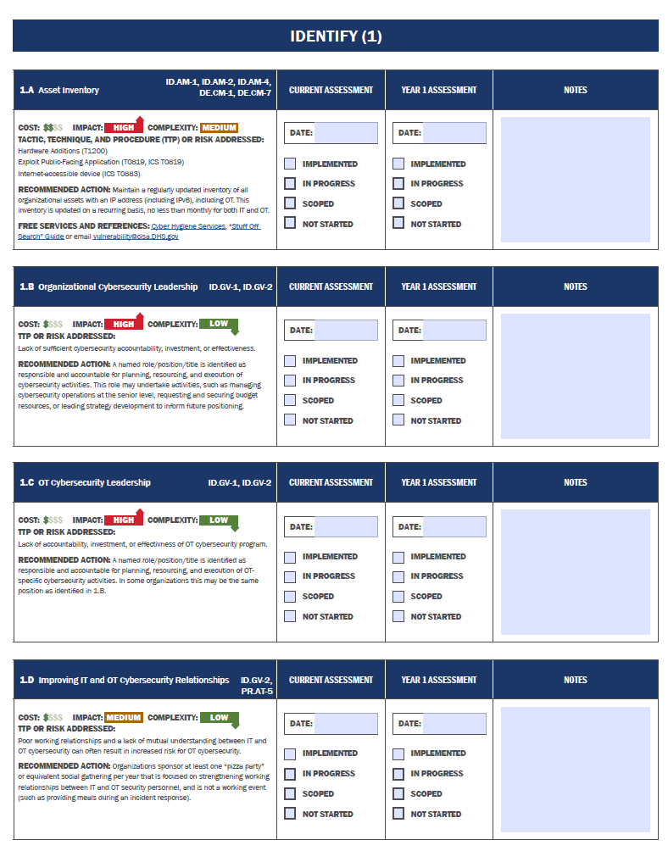
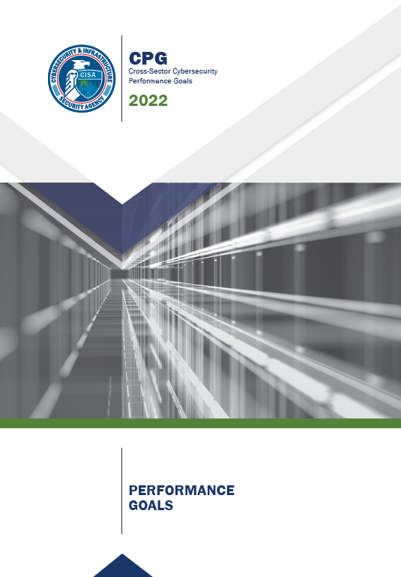
CPG Categories
38 goals aligned to NIST CSF
Account Security
Device Security
Data Security
Governance and Training
Vulnerability Management
Supply Chain / Third Party
Response and Recovery
https://www.cisa.gov/cpg
18

Slide 19
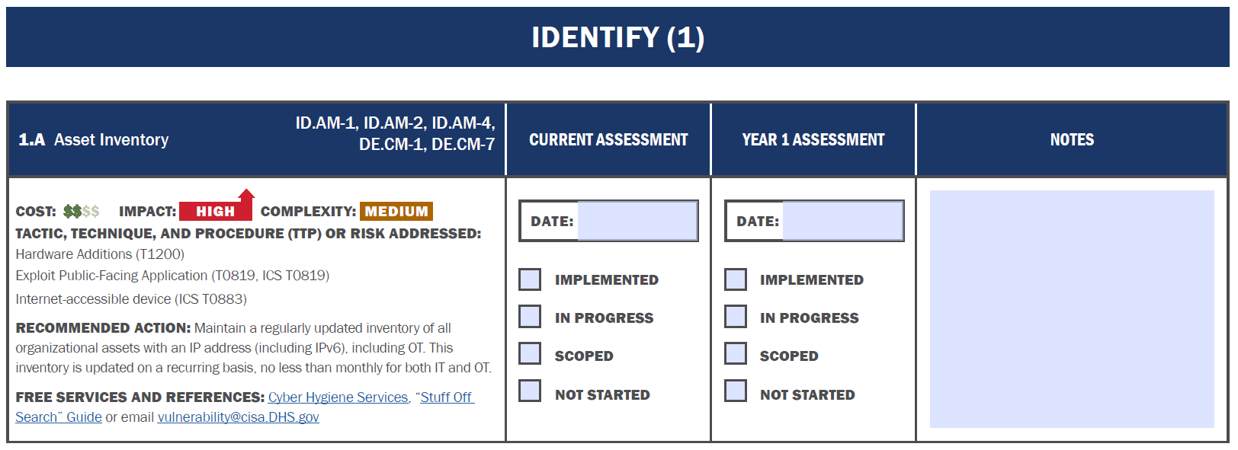
CPG Example
19

Slide 20
Small & Medium Businesses Resources
https://www.cisa.gov/audiences/small-and-medium-businesses

Slide 21
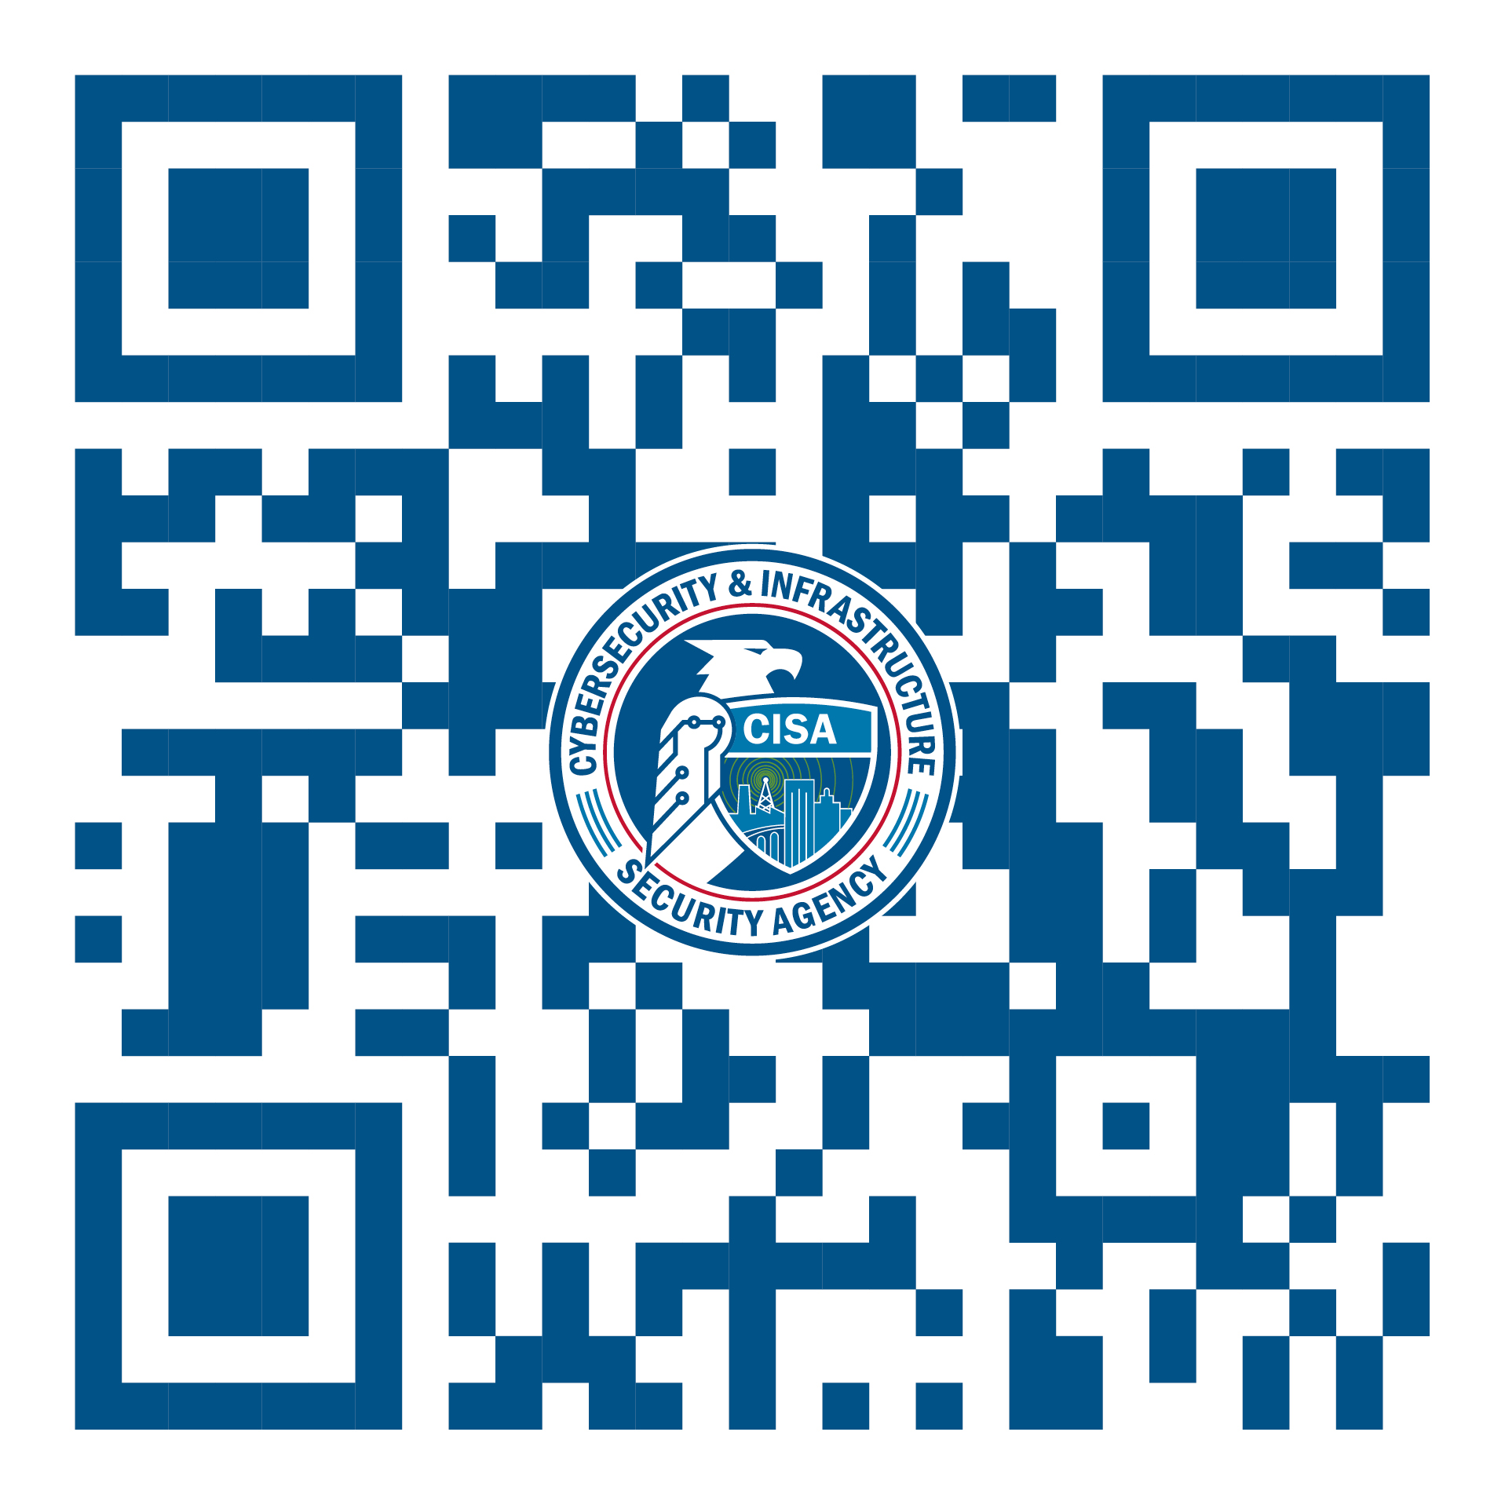
Available Cyber Services & Tools
Cyber Hygiene Services
Known Exploited Vulnerabilities (KEV) Catalog
Bad Practice Catalog
Get Your Stuff Off Search
Cyber Essentials Toolkit
No Cost Tools & Service Catalog:
Antivirus
Malware Removal
Investigation
Log analysis
Scanning
Network packet captures
Protocol analyzer
Intrusion detection & prevention
Threat modeling
Backup
21

Slide 22
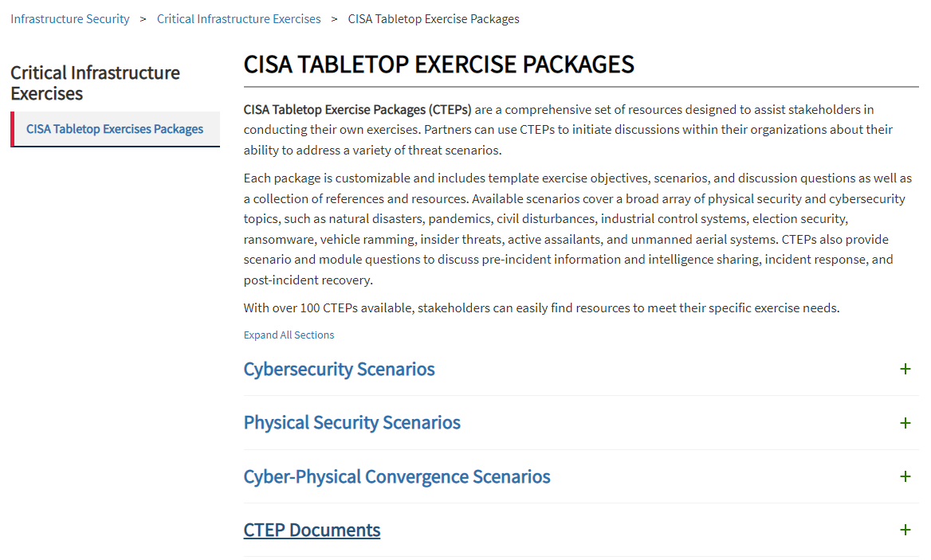
TableTop Exercises (CTEP)
Packages contain a lot of different scenarios:
Cybersecurity
Physical
Natural disasters
Complex scenarios
Documents:
User Guides
Facilitator Guide
After Action Report Templates
https://www.cisa.gov/cisa-tabletop-exercise-packages

Slide 23
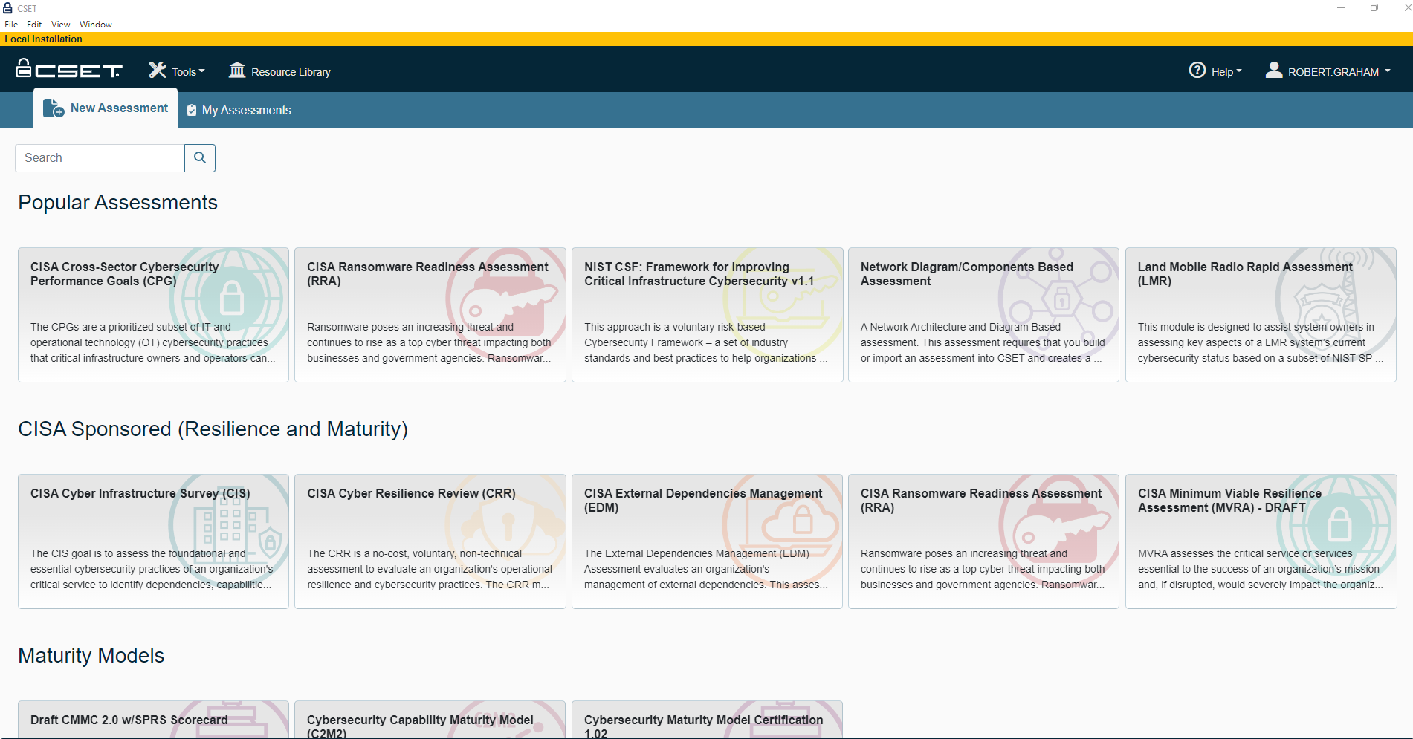
Cybersecurity Evaluation Tool (CSET)
Cybersecurity Evaluation Tool (CSET) is a standalone application developed by CISA with assistance from the National Institute of Standards and Technology (NIST) that assists users in performing self assessments of their cybersecurity posture to establish a security baseline as a starting point for continuous improvement. It guides owners and operators through a step-by-step process that is systematic, disciplined, and repeatable to evaluate IT and ICS network security practices.
https://www.cisa.gov/downloading-and-installing-cset
CSET helps addresses
Where do I stand?
Where do I start?
What are my Priorities?

Slide 24
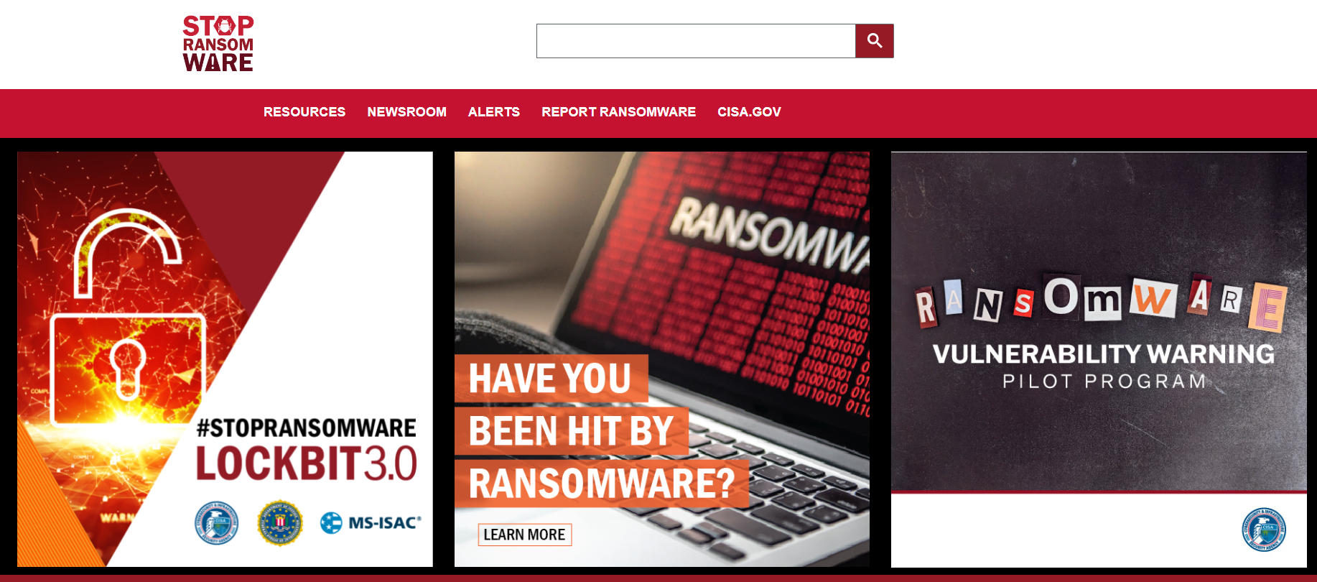
Stop Ransomware
On September 30, 2020, a joint Ransomware Guide was released, which is a customer centered, one-stop resource with best practices and ways to prevent, protect and/or respond to a ransomware attack. CISA and MS-ISAC are distributing this guide to inform and enhance network defense and reduce exposure to a ransomware attack:
Part 1: Ransomware Prevention Best Practices
Part 2: Ransomware Response Checklist
https://www.cisa.gov/stopransomware

Slide 25
Protective DNS (Pilot)

Slide 26
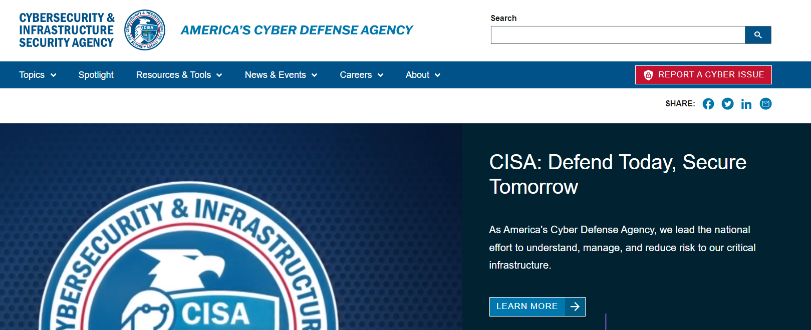
CISA.GOV
Click to Report
Click to Subscribe

Slide 27
Cybersecurity Advisors
Chris Cockburn, St. Louis, MO
christopher.cockburn@cisa.dhs.gov 202-689-7871
Robert Graham, Jefferson City, MO
robert.graham@cisa.dhs.gov 202-705-9949
John Bryant, Kansas City, Mo
john.bryant@cisa.dhs.gov 202-322-9459
Protective Security Advisor
Tommy Miner, Western, MO
thomas.miner@cisa.dhs.gov 816-392-2006
Steven Souders, Eastern, MO
steven.souders@cisa.dhs.gov 314-562-2970
Regional Headquarters
CISARegion7@hq.dhs.gov
CISA Central
Central@cisa.dhs.gov

