Slide 1
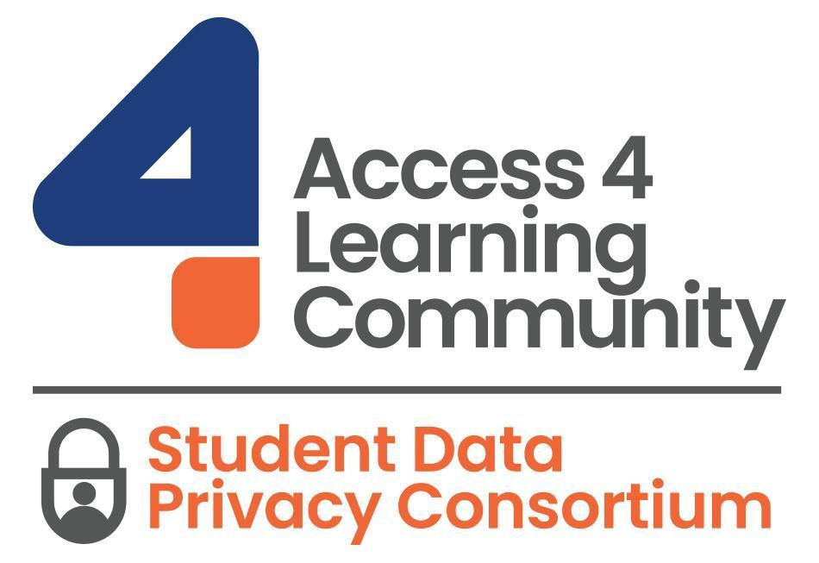
Student Data
Privacy Consortium
Introduction
March 12, 2024

Slide 2
Access 4 Learning Community
Non-Profit started in 1997
Membership driven with schools, districts, regional and state agencies, other professional organizations and marketplace providers in the Community
Collaboratively develops technical blueprints (SIF) for data to move safely and securely between school software applications
Used in every state and Communities in 4 Countries
https://www.A4L.org
Student Data Privacy Consortium
Special Interest Group of A4L Community started in 2015
Maintains its own governance, oversight and resource support
25 State Alliances with over 10,000 schools and 100+ vendors
Addressing privacy “Pain Points”
Working collaboratively on projects, tools, effective practices and partnerships for “tactical student data privacy”
https://sdpc.A4L.org
SDPC
Notes:
Penny

Slide 3
Increased interoperability without the inclusion of privacy requirements
= increased RISK
Notes:
STEVE

Slide 4
Student Data Privacy Consortium Introduction
Agenda
Introductions
Privacy 101
A4L Overview
SDPC Introduction
Resource Registry
National Data Privacy Agreement
Best Practices Across the U.S.
Next Steps for New Alliances
Looking Forward

Slide 5
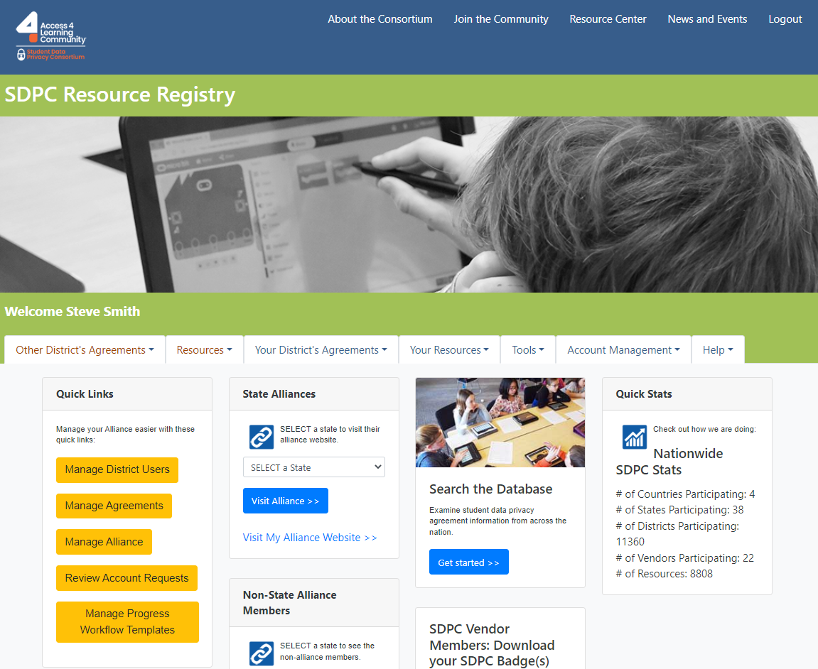
Privacy 101

Slide 6
The Why: Student Privacy Laws
CIPA
PPRA
COPPA
HIPAA
FERPA
STATE
Children’s Internet Protection Act
Protection of Pupils Rights Amendment
Children's’ Online Privacy & Protection Act
Health Insurance Portability & Accountability Act
Family Educational Rights & Privacy Act (1974)
Legislation as well as Local Statutes and Regulations
Internet filters for K–12 schools and libraries to protect children from harmful online content as a condition for federal funding.
Requires parental consent for any surveys that contain political, sexual, mental state, relationships, religious information
Requires operators of websites or online services for children under 13 that they are collecting personal information
Usually HIPAA does not apply because information by definition is part of “education records” under FERPA and, therefore, is not subject to the HIPAA
Schools must have written permission to release any information but allows schools to disclose under certain conditions
40 states have passed 125 student privacy laws since 2013 laws

Slide 7
Student Privacy Laws
CIPA
Children’s Internet Privacy Act
Requires that K–12 schools and libraries in the United States use Internet filters and implement other measures to protect children from harmful online content as a condition for federal funding.

Slide 8
Student Privacy Laws
Illegal, anti-social, self-incriminating and demeaning behavior;
Critical appraisals of other individuals with whom respondents have close family relationships;
Legally recognized privileged or analogous relationships, such as those of lawyers, physicians, and ministers;
Religious practices, affiliations, or beliefs of the student or student's parent; or
Income (other than that required by law to determine eligibility for participation in a program or for receiving financial assistance under such program.)
PPRA
Protection of Pupils Rights Amendment
Requires parental consent for any surveys that contain the following information;
Political affiliations;
Mental and psychological problems potentially embarrassing to the student and his/her family;
Sex behavior and attitudes;

Slide 9
Student Privacy Laws
COPPA
Children's’ Online Privacy & Protection Act
COPPA imposes certain requirements on operators of websites or online services directed to children under 13 years of age, and on operators of other websites or online services that have actual knowledge that they are collecting personal information online from a child under 13 years of age.

Slide 10
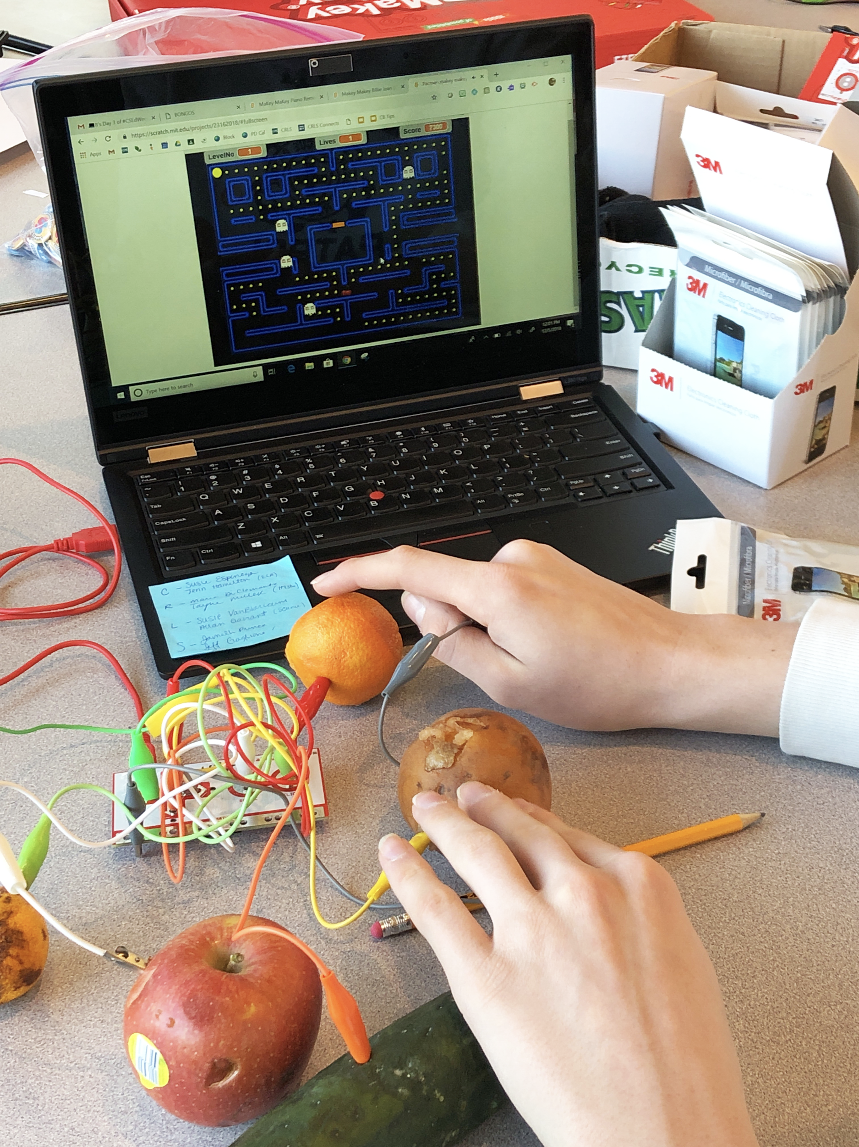
Student Privacy Laws
HIPAA
Health Insurance Portability & Accountability Act
In most cases, the HIPAA Privacy Rule does not apply to an elementary or secondary school because the school either: (1) is not a HIPAA covered entity or (2) is a HIPAA covered entity but maintains health information only on students in records that are by definition “education records” under FERPA and, therefore, is not subject to the HIPAA Privacy Rule.

Slide 11
Student Privacy Laws
FERPA
Family Educational Rights & Privacy Act (1974)
Generally, schools must have written permission from the parent or eligible student in order to release any information from a student's education record. However, FERPA allows schools to disclose those records, without consent, to the following parties or under the following conditions (34 CFR § 99.31).

Slide 12
FERPA (1974)
When FERPA was written....
....“cannot share records without parental consent”

Slide 13
FERPA Exceptions
Other schools to which a student is transferring;
Specified officials for audit or evaluation purposes;
Appropriate parties in connection with financial aid to a student;
Organizations conducting certain studies for or on behalf of the school;
Accrediting organizations;
1
2
3
4
5
To comply with a judicial order or lawfully issued subpoena;
State and local authorities, within a juvenile justice system, pursuant to specific State law.
Appropriate officials in cases of health and safety emergencies;
School officials with legitimate educational interest;
6
7
8
9

Slide 14
Student Privacy Laws
FERPA
School officials with legitimate educational interest.
Data Privacy Agreements (DPA) should cover;
Security and Data Stewardship Provisions.
Collection Provisions.
Data Use, Retention, Disclosure, and Destruction Provisions.
Data Access Provisions.
Modification, Duration, and Termination Provisions.

Slide 15
The What?
Now that you know you SHOULD have a Data Privacy Agreement (DPA) – What’s Next?
The Facts:
13,000+ US Public School Districts
85% of Them Have <5,000 students – Many CIO’s Teach Daily!
The Avg US School Has Anywhere Between 400 and 1,000 Apps
“Freeware” or ”Freemium” Products Are Exploding
Wouldn’t it be great if you could:
Save Resources (time, money, etc.) With ONE Data Privacy Agreement with Vendors
“Piggyback” Off Other Agreements By Districts in Your Alliance?
Seamlessly and Transparently Communicate Those Agreements to Staff, Parents, Etc.

Slide 16
The Registry
sdpc.a4l.org

Slide 17
What is an “Alliance?
Participate: in the SDPC and interact with other Alliance members and SDPC Projects
Convene: stakeholders in their state to identify pain points and gauge the interest in developing a “common contract framework” and tools use as 16 other states have done to date
Develop: contract wording that could be used by all districts with their vendors and provide transparent communications to parents and community members on application usage.
Advocate: for student data privacy and locally support the ongoing needs of the Alliance including bringing possible projects to the larger SDPC Consortium for review and vetting by other Alliances.
Alliance Membership = Point Org and ALL Identified Schools in the State
Notes:
<100 Districts $6250
>100 Districts $8,250
Statewide $15k and $17k
Tom Ingram - Co-Presenter
Director of Information Technology
Escambia County School District

Slide 18
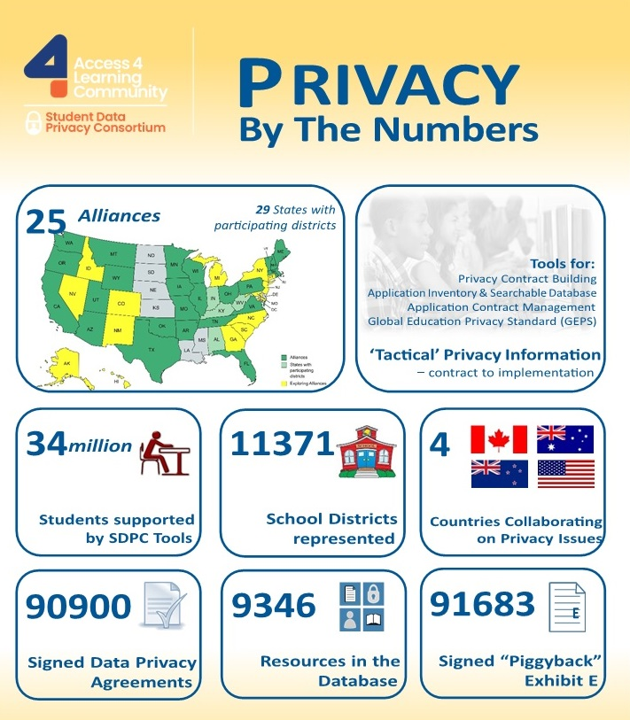
Consortium Projects
Application Resource Registry – Check the Apps!
National Data Privacy Agreement (NDPA) Clause Set - A Research Version Too (NRDPA)
Automate and Certify Software Contract Privacy Obligations
Global Education Security Standard (GESS)
Privacy Effective Practice Sharing
A Growing International Community Setting Clear Expectations Between Vendors and Customers

Slide 19
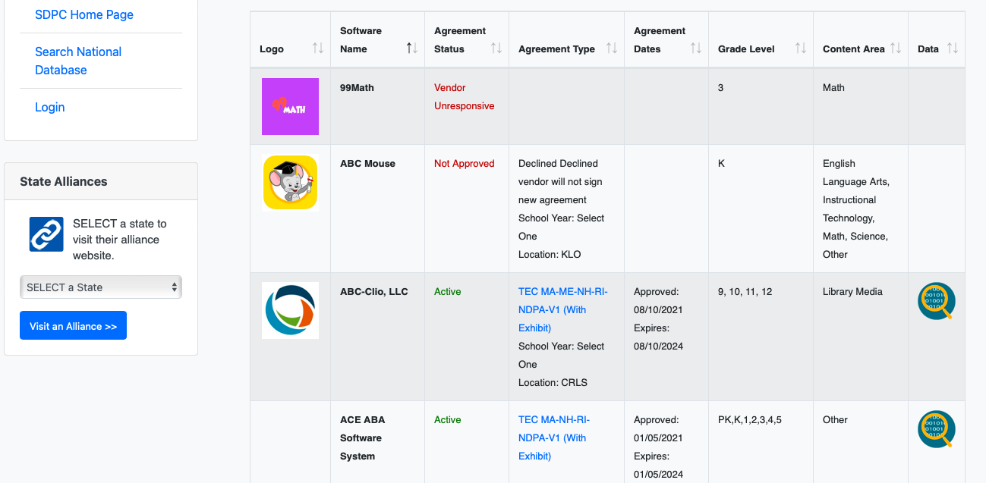
Application and Agreement Management: The SDPC Registry!
Contract/App
Management
Transparency – Put on Your Website!

Slide 20
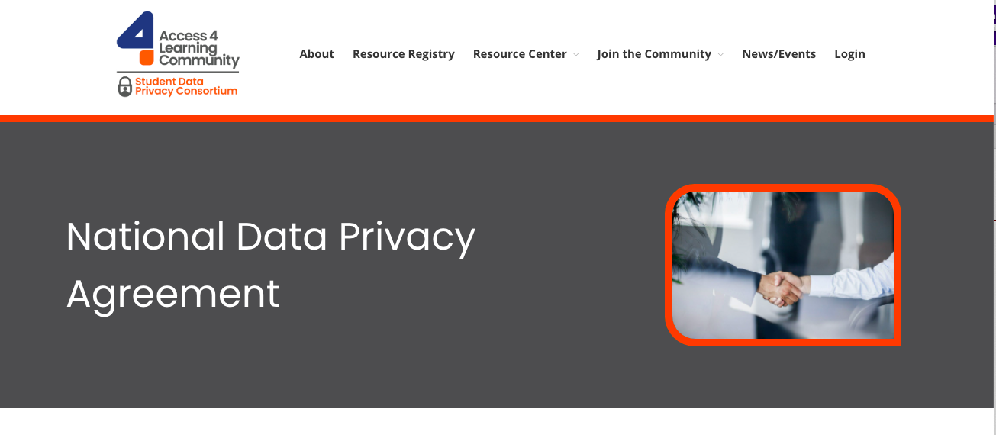
Further increase consistency across Alliance DPAs
Standardize the DPA Format so it looks the same across Alliances
Ease logistics of implementing
Identify common legal requirements across jurisdictions
Provide mechanism to add other jurisdiction specific requirements
Standardize terminology & definitions across jurisdictions
Greater impact on, and buy in, from the vendors = Adoption

Slide 21
Best Practices What’s working across the U.S.
Robust and well-communicated district student data privacy policy
Strong support and endorsement from Superintendent and Administration
Comprehensive training for staff
Rein in the “wild west.” Implement a controlled app vetting process
Slow and steady progression. Ensure sustainable adherence
Help staff understand risks of using unapproved apps
Use technology to identify apps in use throughout the district
Block unapproved apps from district network
Alliance participation in the SDPC community
Collaboration across SDPC Alliance States. Collective efforts to secure signed DPAs
Sharing of noncompliance information with SDPC Alliance States

Slide 22
Ongoing messaging & awareness building
Typical Steps for New a Alliance
Review NDPA & develop adoption strategy
Identify core implementation team
Registry Training
Common language for approaching vendors
DPA roll out strategy
Which vendors
Legal support
Additional district roll out
Training
Support

Slide 23
Looking forward What’s next in creating secure K12 Ecosystems?
Global Education Security Standard (GESS)
Privacy Obligation Documents (PODs)
1
2
3
Putting it all together

Slide 24
Unity Enabling Privacy Expectations
Header
POD – Technical applicability
Contract
Automate Contract Clause Expectations Exchange and Vendor Verification
The “POD”
(Privacy Object Document)
Legal obligations
Technical obligations
Data access
Subject specific obligations
Condition list
Data deletion obligations
Data controller obligations
Data processor obligations
Data sub-processor details
Notes:
Ben

Slide 25
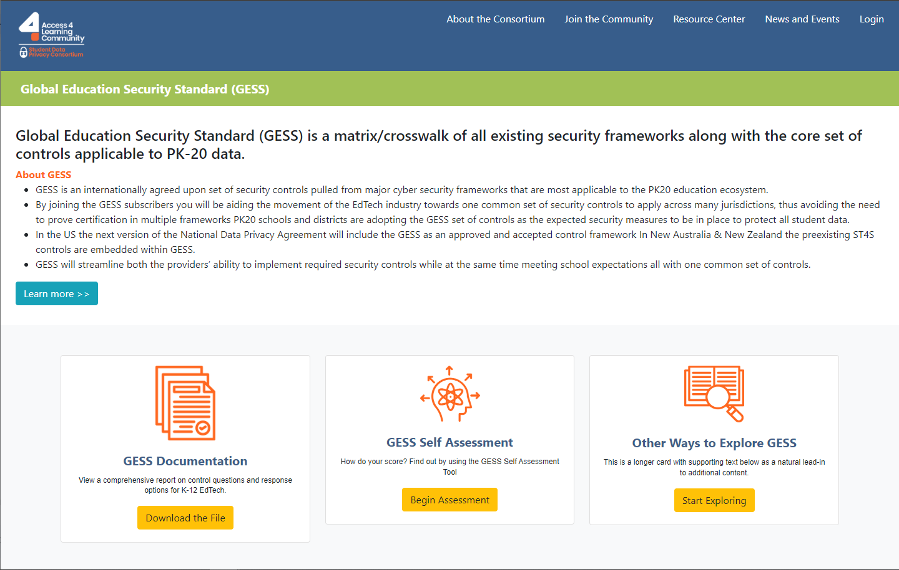

Slide 26
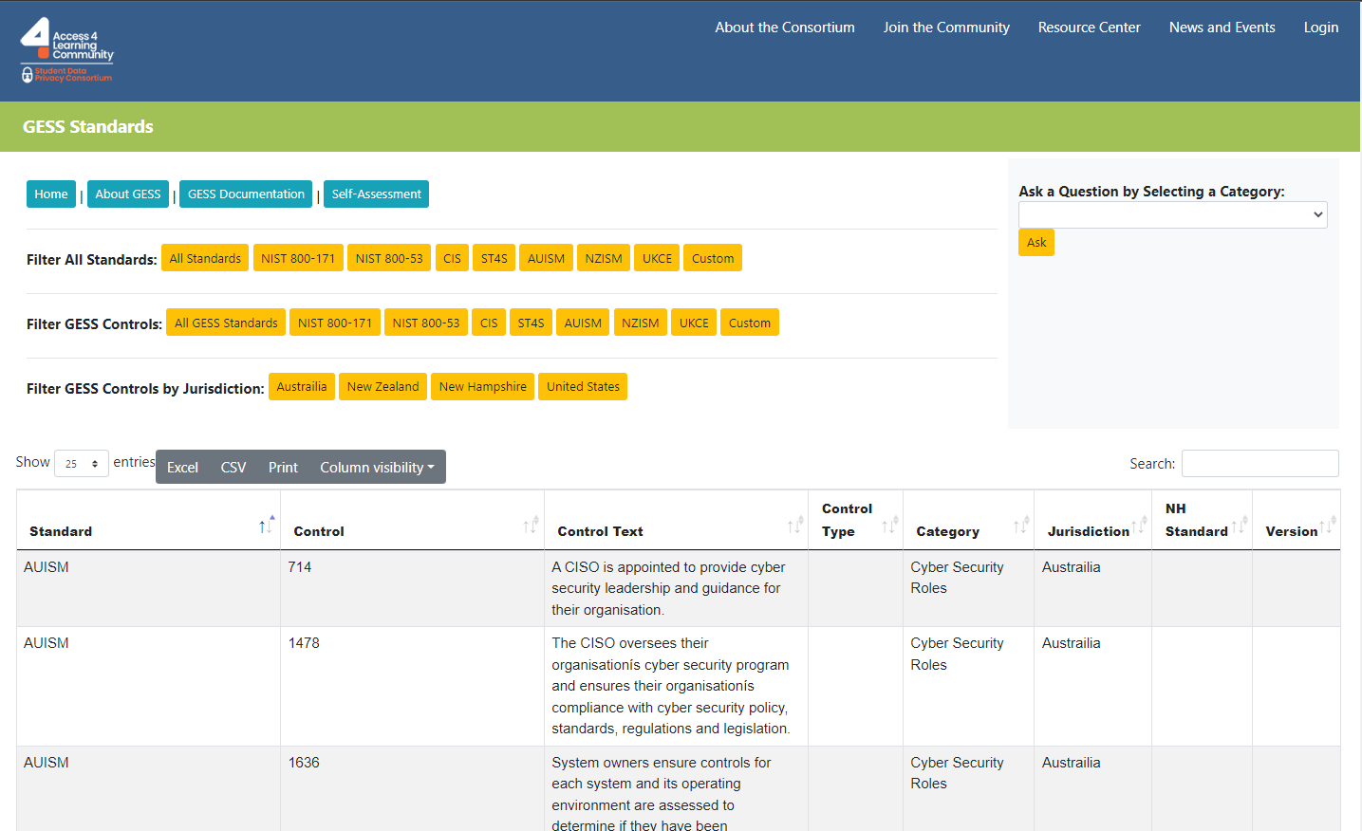

Slide 27
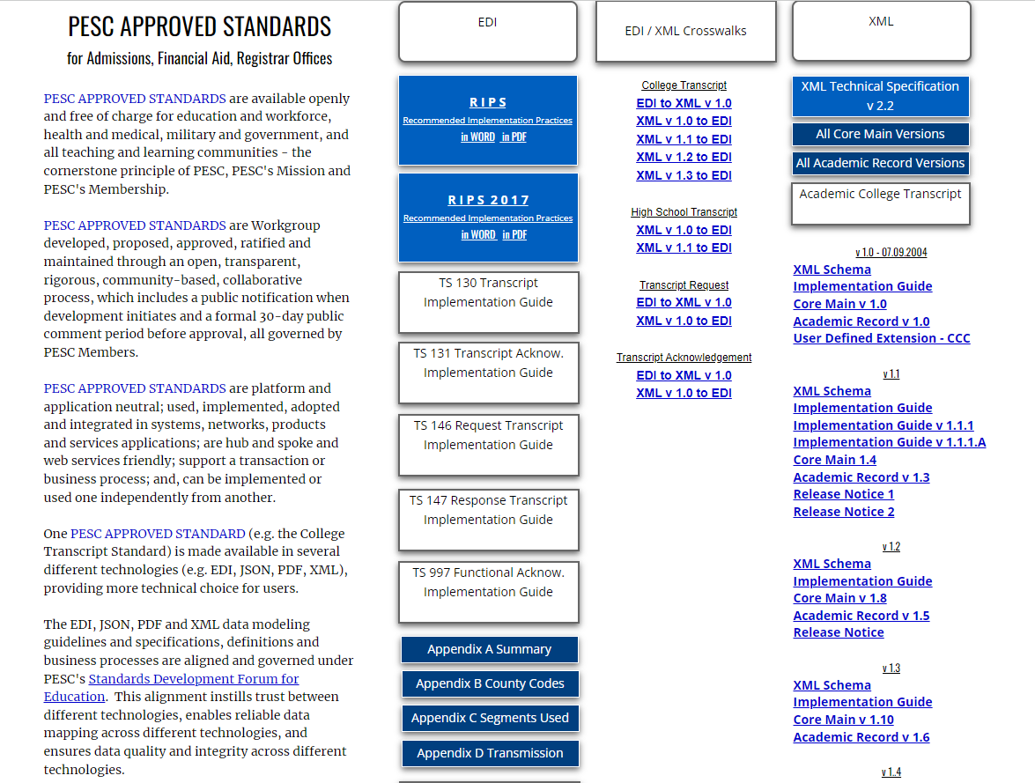
PESC Postsecondary Electronic Standards Council
Notes:
Ben

Slide 28
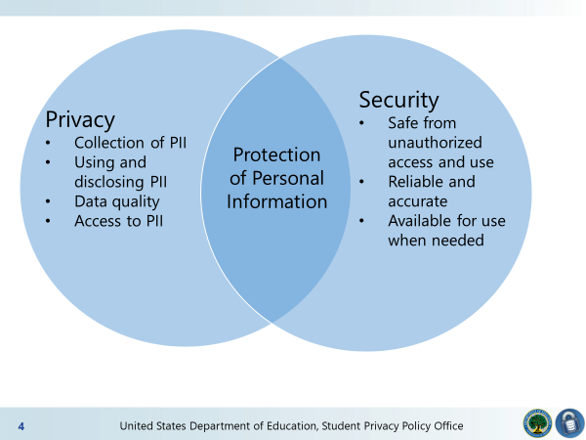

Slide 29
Q & A

