Slide 1
IT Perspectives on Research Challenges and Future Directions Matthew Keeler – Director, IT Research Support Solutions

Slide 2
How did I end up here?
Studied CS at Vanderbilt
Came back to Missouri for Animal Science
Went to work in the poultry industry
Came back to Missouri as research specialist, then IT
Director IT Vet Med
Associate Director Distributed IT through Transition
AD, then Director IT RSS

Slide 3
What do I have to share?
Times are always “interesting” or “challenging”
Some successes to learn from… And some mistakes
IT is a set of resources to enable research
Identify what’s important
Adapt
Reminder: We are agents for good

Slide 4
Predicting the future...
Not my strongest suit
Streaming video
Linux in the mainstream
Windows mobile
The Internet
Changing IT models and specialized support needs
Quantum
Which leads into…

Slide 5
Predicting the future...
I don’t have to!
Researchers - faculty and students drive direction
Yes, we need to keep up on emerging tech
Yes, we need to be prepared to adapt
Yes, we need to have a team with diverse skills and strengths and hunger for learning

Slide 6
Going forth into the future
Use researcher insight to ramp up resources for future needs
Be prepared to support developing technologies
Be prepared to explore the novel/emerging ones alongside researchers
Apply team capabilities to be ready for the risks and chaos of new technologies
Prioritize – match team commitment to institutional priorities
Now on to some specific focus areas…

Slide 7
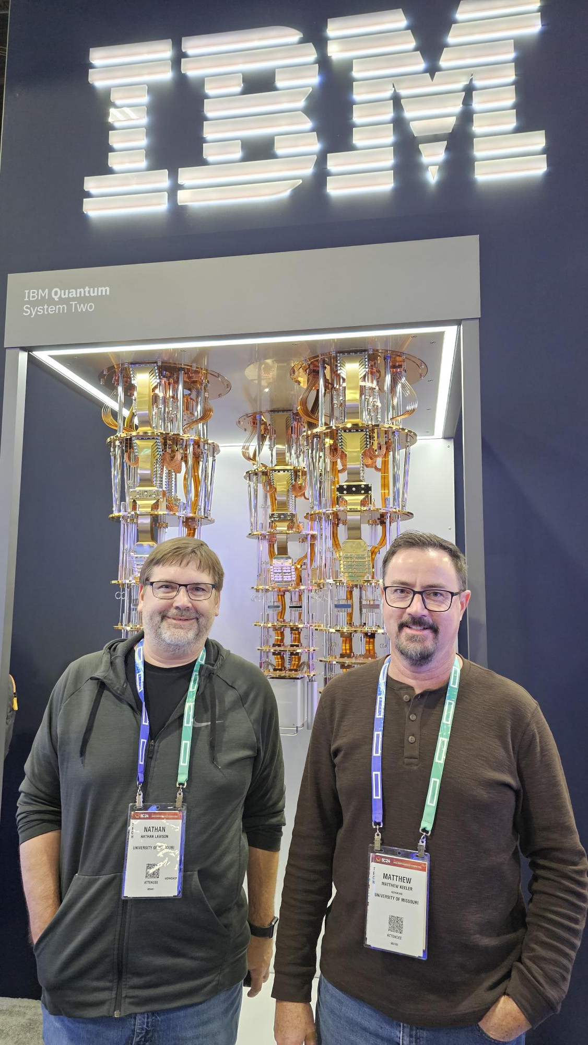
Focus on Quantum computing (& friends)
(It’s OK that I was wrong)
Mizzou Quantum Innovation Center
An investment beyond IT
Regional initiatives
GPN Quantum Leap Challenge Institute
GPN exploring quantum networking ideas
Nathan Lawson and me at SC24

Slide 8
Focus on HPC
Hellbender
“Interesting times” April 2023
Hellbender expansion
“Still interesting” April 2025
More GPU!
Next?
CUI, Health, AI
Further down the road?

Slide 9
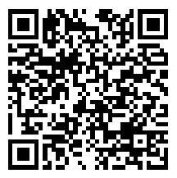
Focus on AI
Research on AI
Research using AI
AI enabling research support
Recent AI symposium hosted by A&S at MU:
Note, all uncredited illustrations in this presentation were generated by MS CoPilot. When asked to create a picture of itself, this is one of the representations it produced.

Slide 10
Focus on Data Management
Understanding the needs and incentives
Lessons learned from trying to solve with vended solutions
Lessons learned from trying to augment with grant supported solutions
Looking ahead with partners for effective solutions

Slide 11
Focus on Security & Restricted Research
Compliance & Security Challenges
Tackling CUI basics
Tackling CUI HPC
Tackling health data
Kinds of risk
Research custom development

Slide 12
Focus on Partnerships
Internal
Libraries
Sponsored Programs Administration
Constructive faculty & labs
Other IT folks
External
Great Plains Network
Southeast Conference
Association of American Universities
CIMUSE

Slide 13
Focus on Uncertainty
“Natural” uncertainty (inherent to science & technology)
Rapidly changing and developing technologies like AI & quantum
Demographics
Small steps & Break-throughs
Geopolitical uncertainty
Funding
Collaboration
Organizational impacts

Slide 14
Focus on Contextual Wisdom
Growing research-savvy IT pros the old way
The gap
Growing research-savvy IT pros for the future

Slide 15
Thanks for your time!
Questions?
Connecting:
Matthew Keeler
University of Missouri
Director, IT Research Support Solutions
keelerm@missouri.edu

