Slide 1
MOREnet Cybersecurity
Connie Coy
Sonia Kesselring
John Riley
security@more.net

Slide 2
Introductions and New Staff Member
Sonia Kesselring
Notes:
Connie

Slide 3
What's New
BitSight
Password Manager
Vulnerability Assessments
Incident Response Plan - MOREnet
Student Data Privacy
Trends & Challenges
MOREnet Solutions
Notes:
Connie

Slide 4
BitSight
Insecure Protocol TLS
TLS 1.0, 1.1
Expired Certificates
Open Ports
Unsupported software -Open SSH, IIS, Server, etc
Notes:
We use BitSight to scan for vulnerabilities on all MOREnet connections. With this tool, we (you) have discovered unsupported software, open ports, Insecure software such as old tls and Open ssh, and expired certificates. We/You have been able to remediate those vulnerabilites

Slide 5
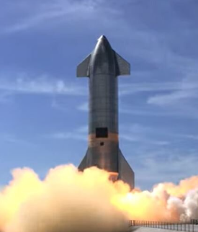
Password Manager
What we are looking for in an enterprise solution:
Zero Trust/knowledge
Individual tenants
Local management
Super user recoverable
Consortium Pricing
Notes:
Final adjustments were made to the FRP. Ready to send this out for a enterprise password manager with local tenants.

Slide 6
Vulnerability Assessments
New service Summer, 2025
Scan, reporting, and remediation
Researching companies
Add-On Service
Notes:
Connie

Slide 7
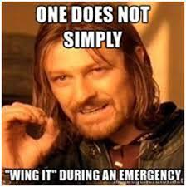
IRP
Tabletop exercise with Homeland Security
Department procedures documentation
2024-25 NCSR
UM Plan – MOREnet Plan – Group Playbooks
Test it: Functional TTX
Notes:
Sonia

Slide 8
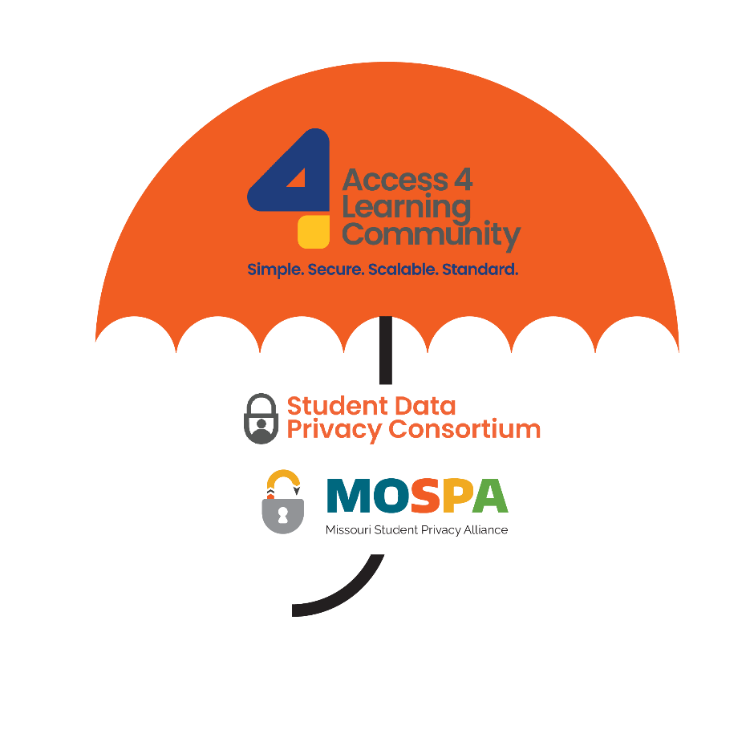
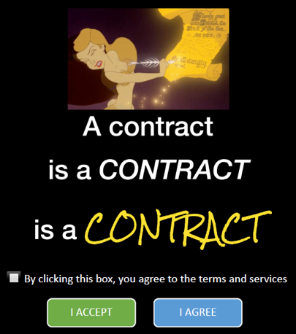
Student Data Privacy
NDPA and Resource Registry
Higher Education Data Privacy
and Services Agreement
College and Provider
Streamline processes
Interested in joining? Email dataprivacy@more.net
Notes:
School interoperability Framework; SDPC special interest group
Mark Williams
F3 Law CA
Jennifer Thorpe
System Privacy Officer UM
Connie
Addresses the need to protect data based on FERPA, PPRA, Graham-Leach Bliley Act
GDPR.
Fully developed AI language.
Alignment with HECVAT
Section 1.5 Placeholder for Artificial Intelligence.
Section 4.6.1 Distinction between a request for specific data to be deleted, v. a request for the data in general to be deleted. (from Jennifer’s Addendum)
Section 4.8.1 Bright line communication prohibition to individuals. (from Jennifer’s Addendum)
Section 5.0 Digital Accessibility Access (from Jennifer’s Addendum)
Section 5.2 Security Aduit (paraphrase from Jennifer’s Addendum)
Section 5.3 Data Security: Added sections from Graham-Leach-Bliley
Section 5.4 Data Breach Added subsections 6, 7, and 8 (from Jennifer’s Addendum)
Attorney’s Fees, in Standard Clauses and is marked optional.

Slide 9
Trends– More Complex
Credential Compromise
Data volume increase – exposed/incident
Multi- Cloud Environments
Vulnerabilities
AI
Embedded in all software
Mutate malicious code in real-time to avoid detection
Deepfakes
Audio;Video
Phishing, Vishing, SMishing
Data Privacy Awareness
Notes:
Sonia - Credential
Connie
Data volume increase AI and 5G– more data exposed
IoT; Industrial control systems
Supply chain, healthcare, infrastructure
John
AI – introduces new vulnerabilities, uptick in social engineering attacks
Over 400 percent increase in Vishing
Transcripts to colleges through third party apps – from SIS – Parental consent/Student initiated
Staff Shortage/Turnover/Training

Slide 10
Challenges
Defining Zero Trust for your Organization
SOCs
Limited Budgets/Escalating Threats
Trained staff
Adapting Cybersecurity Best Practices
Time;Training
Cyber Security Staffing
Notes:
Connie, John, Sonia
Zero Trust – What does that mean? Have a discussion 2 factor – key fobs, biometric, how many layers, segmentation, verification. Balance between providing timely access – productivity with security.
Security Operations Center – Internal or third party
Staff Shortage/Turnover/Training

Slide 11
MOREnet Solutions
Network and Cybersecurity Assessments
Threat Mitigation
Incident Response Planning Assistance
Tabletop Exercises
Cybersecurity Best Practices Training
Consortium Discounts
EDR, Firewalls, Infosec IQ, Akamai SIA, Aruba, MS Licensing, etc.
LAN Services and Network Consulting
FortiGuard Services
Virtual Servers
Backup Solutions
Notes:
Connie, John, Sonia

Slide 12
Questions?
security@more.net

