Slide 1
The CIMUSE Consortium
Jeffrey N. Woodford, Ph.D.
Professor of Chemistry
Missouri Western State University
Presentation to MoHEIT
April 10, 2025

Slide 2
CIMUSE Consortium
Computational Infusion for Missouri Undergraduate Science & Engineering
An NSF-funded consortium of PUIs in Missouri for advancing supercomputing in the undergraduate curriculum and research

Slide 3
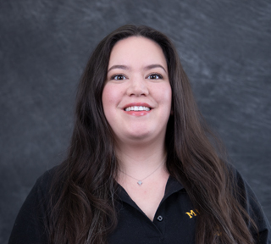
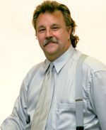
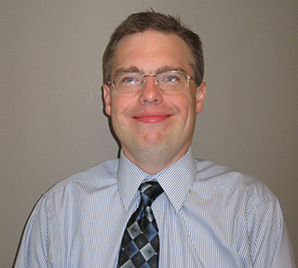
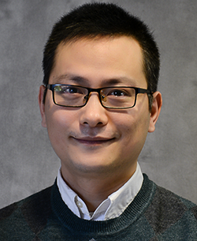
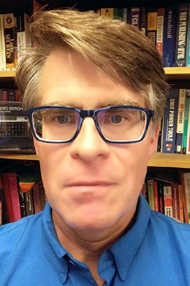
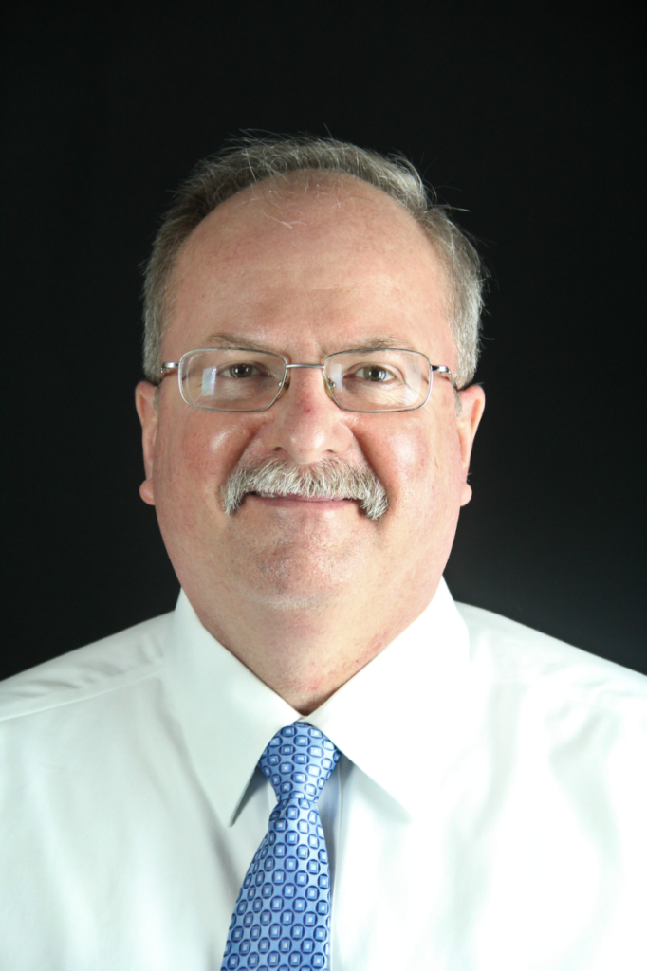
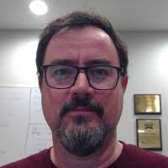
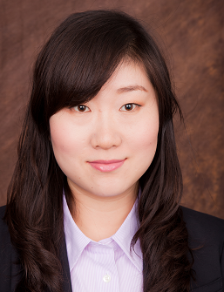
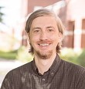
Dr. Jeff Woodford
Professor, Chemistry
Mr. Chip Byers
Director, New Initiatives
Dr. Baoqiang Yan
Professor, Computer Science
Dr. Ashley Elias
Professor, Biology
Dr. Marcus Bond
Professor, Chemistry
Dr. Xiaoyuan Suo
Professor, Computer Science
Mr. Mark Bookout
Former Director, MU RSS
Mr. Matt Keeler
Interim Director
Dr. Colin DeGraf
Professor, Physics

Slide 4
Three Major Goals
Goal 1: Do high-quality science with undergraduates using the supercomputer.
Goal 2: Develop educational materials and expand supercomputer usage into the undergraduate curriculum.
Goal 3: Broaden participation among Missouri PUIs by expanding the consortium.

Slide 5
Why focus so much on supercomputing at PUIs?
Computer simulation has gone from a niche field practiced by just a few experts in a department, to a widespread practice across all domains of science
Where are all of these researchers going to come from?

Slide 6
Supercomputer Specifications
12 Dell PowerEdge R6625 Servers
Each one has:
2x AMD EPYC 9754 128-core Processors per server (256 cores per server)
1024 GB RAM (3200 MT/s) per server
1.6TB local Enterprise NVMe storage per server
Networking:
On-board 10 Gbit/s Ethernet
Mellanox IB ConnectX-6 VPI network adapter (single port, supports up to 200 Gbit/s for InfiniBand)
Storage:
100 TB total of tiered storage

Slide 7
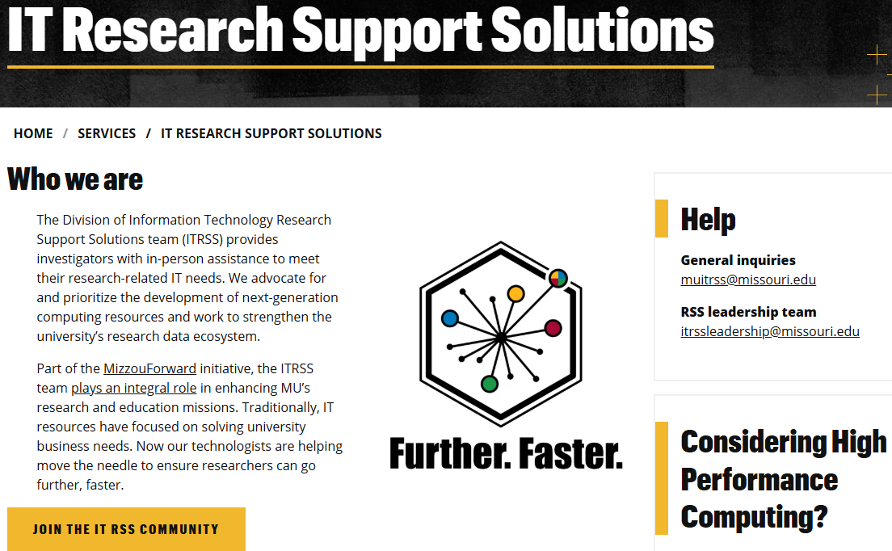
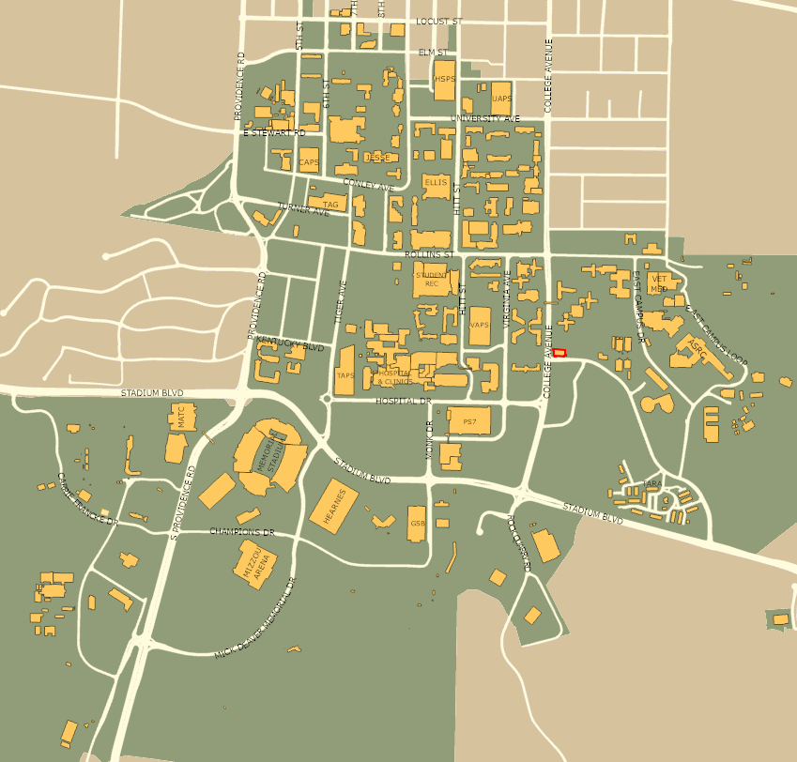
Where is the supercomputer located?
At Research Support Solutions (RSS) at the University of Missouri-Columbia

Slide 8
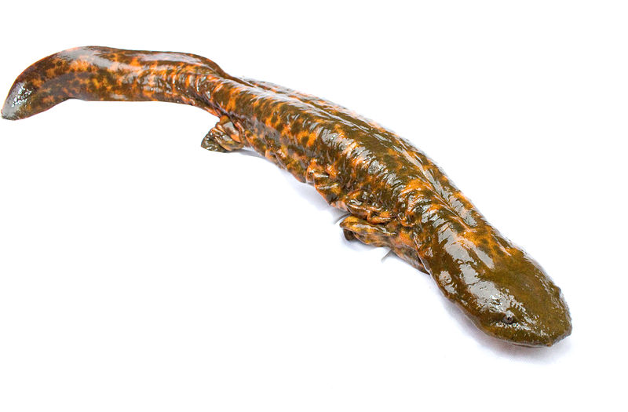
How does the MU-CIMUSE partnership work?
The CIMUSE supercomputer is integrated into the MU main supercomputer, Hellbender
CIMUSE members have priority access to the 12 nodes
The consortium pays MU an annual management fee for the maintenance and upkeep of the 12 nodes

Slide 9
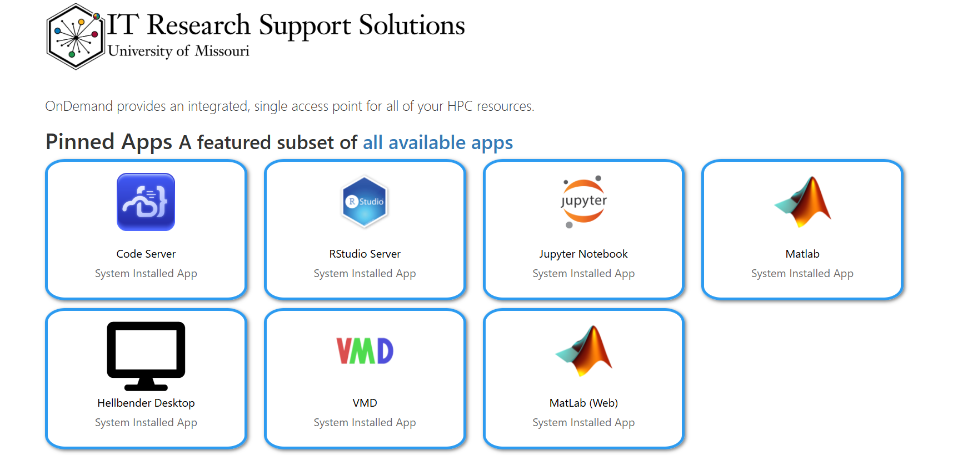
How does supercomputer access work?
OpenOnDemand – a web-based interface
Federated identity will be implemented using InCommon
Access via ORCID will be one of the options

Slide 10
Questions?
Next CIMUSE Workshop: July 31-Aug 1, 2025 in Columbia
https://www.more.net/about-us/morenet-research/nsf-grant-cimuse/
jwoodford@missouriwestern.edu
Funded by: NSF Campus Cyberinfrastructure Grant 23-22084

